Slide 1
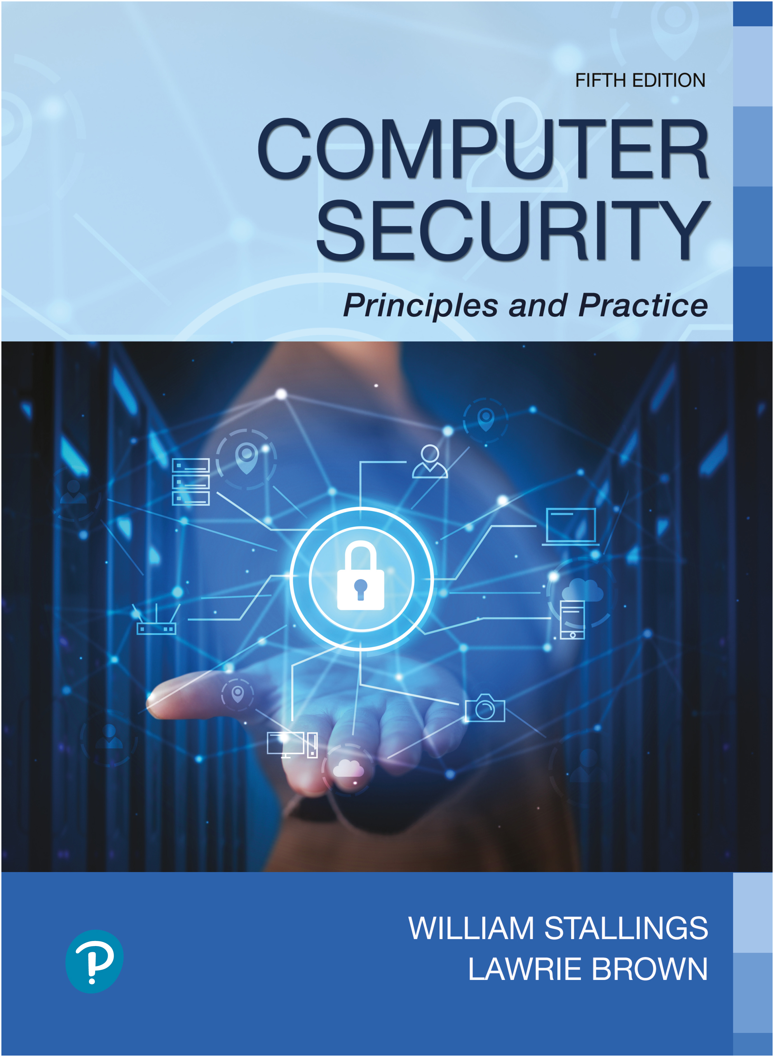

Computer Security: Principles and Practice
Fifth Edition
Chapter 13
Cloud and I o T Security
Copyright © 2024, 2018, 2015 Pearson Education, Inc. All Rights Reserved
Notes:
If this PowerPoint presentation contains mathematical equations, you may need to check that your computer has the following installed:
1) MathType Plugin
2) Math Player (free versions available)
3) NVDA Reader (free versions available)
The two most significant developments in computing in recent years are cloud computing and the Internet of Things (I o T). In both cases, security measures tailored to the specific requirements of these environments are evolving. This chapter begins with an overview of the concepts of cloud computing followed by a discussion of cloud security. Then, the chapter examines the concepts of I o T and closes with a discussion of I o T security.
For further detail on the material on cloud computing and IoT in Sections 13.1 and 13.4, see [S T A L16a].

Slide 2
Cloud Computing (1 of 2)
N I S T defines cloud computing in N I S T S P-800-145 (The N I S T Definition of Cloud Computing, September 2011) as follows:
“Cloud computing: A model for enabling ubiquitous, convenient, on-demand network access to a shared pool of configurable computing resources (e.g., networks, servers, storage, applications, and services) that can be rapidly provisioned and released with minimal management effort or service provider interaction. This cloud model promotes availability and is composed of five essential characteristics, three service models, and four deployment models.”
Notes:
N I S T defines cloud computing in N I S T S P-800-145 (The N I S T Definition of Cloud Computing ) as follows:
Cloud computing: A model for enabling ubiquitous, convenient, on-demand network access to a shared pool of configurable computing resources (e.g., networks, servers, storage, applications, and services) that can be rapidly provisioned and released with minimal management effort or service provider interaction. This cloud model promotes availability and is composed of five essential characteristics, three service models, and four deployment models.

Slide 3
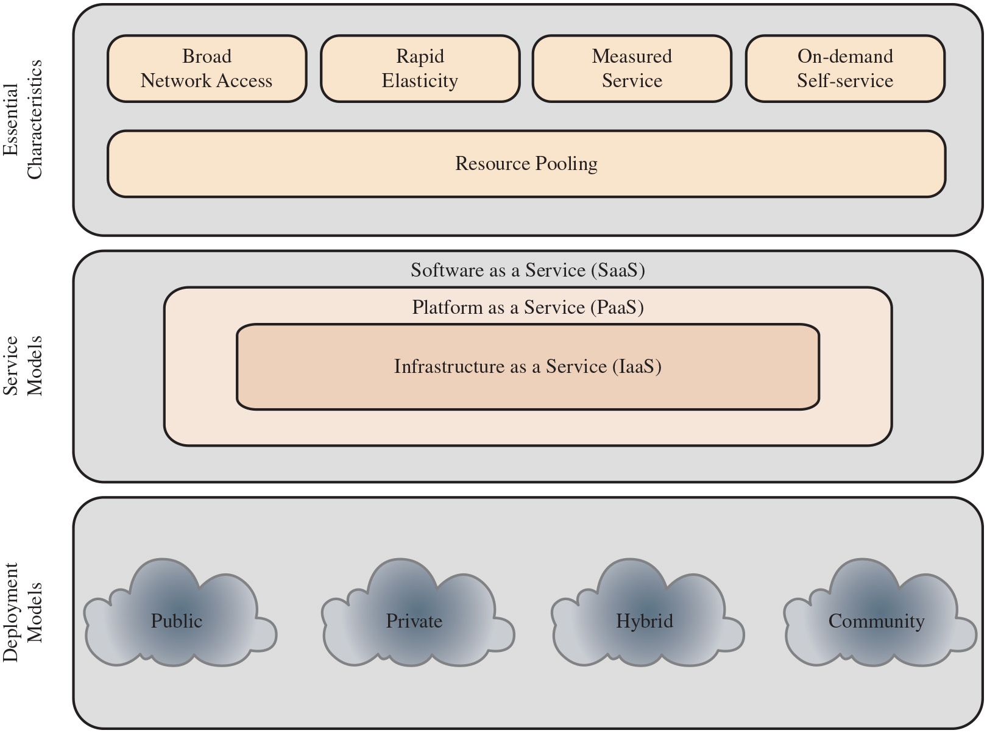
Figure 13.1
Cloud Computing Elements
Notes:
The definition refers to various models and characteristics, whose relationship is illustrated in Figure 13.1. The essential characteristics of cloud computing include the following:
• Broad network access: Capabilities are available over the network and accessed through standard mechanisms that promote use by heterogeneous thin or thick client platforms (e.g., mobile phones, laptops, and tablets) as well as other traditional or cloud-based software services.
• Rapid elasticity: Cloud computing gives you the ability to expand and reduce resources according to your specific service requirement. For example, you may need a large number of server resources for the duration of a specific task. You can then release these resources upon completion of the task.
• Measured service: Cloud systems automatically control and optimize resource use by leveraging a metering capability at some level of abstraction appropriate to the type of service (e.g., storage, processing, bandwidth, and active user accounts). Resource usage can be monitored, controlled, and reported, providing transparency for both the provider and consumer of the utilized service.
• On-demand self-service: A cloud service consumer (C S C) can unilaterally provision computing capabilities, such as server time and network storage, as needed automatically without requiring human interaction with each service provider. Because the service is on demand, the resources are not permanent parts of the consumer’s IT infrastructure.
Resource pooling: The provider’s computing resources are pooled to serve multiple C S C s using a multitenant model with different physical and virtual resources dynamically assigned and reassigned according to consumer demand. There is a degree of location independence, in that the C S C generally has no control or knowledge of the exact location of the provided resources but may be able to specify location at a higher level of abstraction (e.g., country, state, or datacenter). Examples of resources include storage, processing, memory, network bandwidth, and virtual machines (V M s). Even private clouds tend to pool resources between different parts of the same organization. The essential characteristics are as follows. Resource pooling, broad network access, rapid elasticity, measured service, and on demand self service. The service models are depicted in concentric rectangles. The components from innermost to outermost rectangles are as follows. Infrastructure as a service I a a S, platform as a service P a a S, and software as a service S a a S. Deployments models types are as follows. Public, private, hybrid, and community.
Long Description:
Cloud computing is defined with rectangular boxes labeled deployment models, service models, and essential characteristics. Deployment models include public, private, hybrid and community models depicted as clouds. Service models can be divided into three nested layers listed from the center outward. Infrastructure as a service at the center, I a a S. Platform as a service, P a a S around it. Software as a service, S a a S around the previous. Essential characteristics include small rectangular boxes at the top labeled broad network access, rapid elasticity, and measured service, and on-demand self-service with common resource pooling.

Slide 4
Cloud Service Models
N I S T defines three service models that can be viewed as nested service alternatives
Software as a service (S a a S)
Platform as a service (P a a S)
Infrastructure as a service (I a a S)
Notes:
N I S T S P 800-145 defines three service models that can be viewed as nested service alternatives: software as a service (S a a S), platform as a service (P a a S), and infrastructure as a service (I a a S).

Slide 5
Software as a Service (S a a S)
S a a S provides service to customers in the form of software, specifically application software, running on and accessible in the cloud
It enables the customer to use the cloud provider’s applications running on the provider’s cloud infrastructure
The applications are accessible from various client devices through a simple interface, such as a Web browser
Instead of obtaining desktop and server licenses for software products it uses, an enterprise obtains the same functions from the cloud service
The use of S a a S avoids the complexity of software installation, maintenance, upgrades, and patches
Examples of this service are Google Gmail, Microsoft 365, Salesforce, Citrix GoToMeeting, and Cisco WebEx
Notes:
S a a S provides service to customers in the form of software, specifically application software, running on and accessible in the cloud. SaaS follows the familiar model of Web services, in this case applied to cloud resources. S a a S enables the customer to use the cloud provider’s applications running on the provider’s cloud infrastructure. The applications are accessible from various client devices through a simple interface, such as a Web browser. Instead of obtaining desktop and server licenses for software products it uses, an enterprise obtains the same functions from the cloud service. The use of S a a S avoids the complexity of software installation, maintenance, upgrades, and patches. Examples of services at this level are Google Gmail, Microsoft 365, Salesforce, Citrix GoToMeeting, and Cisco WebEx.
Common subscribers to S a a S are organizations that want to provide their employees with access to typical office productivity software, such as document management and email. Individuals also commonly use the SaaS model to acquire cloud resources. Typically, subscribers use specific applications on demand. The cloud provider also usually offers data-related features, such as automatic backup and data sharing between subscribers.

Slide 6
Platform as a Service (P a a S)
A P a a S cloud provides service to customers in the form of a platform on which the customer’s applications can run
P a a S enables the customer to deploy onto the cloud infrastructure customer-created or acquired applications
A P a a S cloud provides useful software building blocks plus a number of development tools, such as programming language tools, run-time environments, and other tools that assist in deploying new applications
In effect, P a a S is an operating system in the cloud
It is useful for an organization that wants to develop new or tailored applications while paying for the needed computing resources only as needed, and only for as long as needed
Examples of P a a S include AppEngine, Engine Yard, Heroku, Microsoft Azure, Force.com, and Apache Stratos
Notes:
A P a a S cloud provides service to customers in the form of a platform on which the customer’s applications can run. P a a S enables the customer to deploy onto the cloud infrastructure customer-created or acquired applications. A P a a S cloud provides useful software building blocks plus a number of development tools, such as programming language tools, run-time environments, and other tools that assist in deploying new applications. In effect, P a a S is an operating system in the cloud. P a a S is useful for an organization that wants to develop new or tailored applications while paying for the needed computing resources only as needed, and only for as long as needed. AppEngine, Engine Yard, Heroku, Microsoft Azure, Force. com, and Apache Stratos are examples of P a a S.

Slide 7
Infrastructure as a Service (I a a S)
With I a a S, the customer has access to the resources of the underlying cloud infrastructure
The cloud service user does not manage or control the resources of the underlying cloud infrastructure, but has control over operating systems, deployed applications, and possibly limited control of select networking components
I a a S provides virtual machines and other virtualized hardware and operating systems
I a a S offers the customer processing, storage, networks, and other fundamental computing resources so the customer is able to deploy and run arbitrary software, which can include operating systems and applications
I a a S enables customers to combine basic computing services, such as number crunching and data storage, to build highly adaptable computer systems
Examples of I a a S are Amazon Elastic Compute Cloud, Microsoft Windows Azure, Google Compute Engine, and Rackspace
Notes:
With I a a S, the customer has access to the resources of the underlying cloud infrastructure. The cloud service user does not manage or control the resources of the underlying cloud infrastructure, but has control over operating systems, deployed applications, and possibly limited control of select networking components (e.g., host firewalls). I a a S provides virtual machines and other virtualized hardware and operating systems. I a a S offers the customer processing, storage, networks, and other fundamental computing resources so the customer is able to deploy and run arbitrary software, which can include operating systems and applications. I a a S enables customers to combine basic computing services, such as number crunching and data storage, to build highly adaptable computer systems.
Typically, customers are able to self-provision this infrastructure, using a Webbased graphical user interface that serves as an I T operations management console for the overall environment. A P I access to the infrastructure may also be offered as an option. Examples of I a a S are Amazon Elastic Compute Cloud (Amazon E C 2), Microsoft Windows Azure, Google Compute Engine (G C E), and Rackspace.

Slide 8
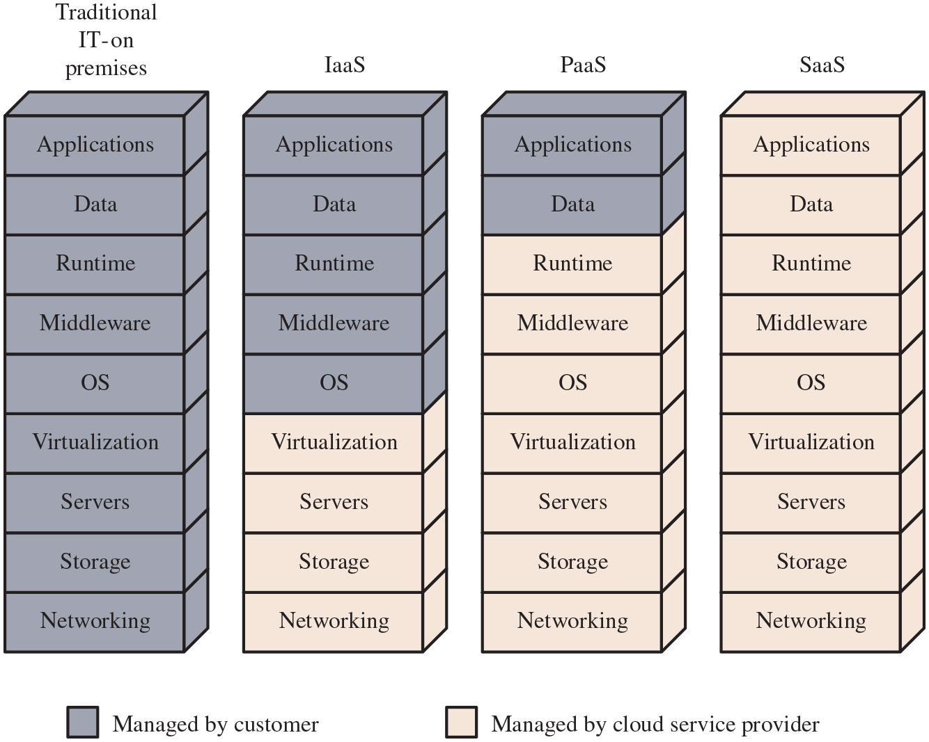
Figure 13.2
Separation of Responsibilities in Cloud Service Models
Notes:
Figure 13.2 compares the functions implemented by the cloud service provider for the three service models. The functions listed are as follows. Applications, data, runtime, middleware, O S, visualization, servers, storage, networking. In traditional I T on premises all functions are managed by customers. In I a a S model, the functions, applications, data, runtime, middleware, and O S, are managed by customer. The functions visualizations, servers, storage, and networking, are managed by cloud service provider. In P a a S model, application and data, are managed by customers, and other services are managed by cloud service providers. In S a a S model all functions are managed by cloud service providers.
Long Description:
A total of four models labeled Traditional I T on premises, I a a S, P a a S, and S a a S, depicted as sets of 9 boxes stacked one upon the other. In each model, the system has the following layers, listed from bottom to top. Networking, storage, servers, virtualization, O S, middleware, run time, data, and applications. In traditional I T on the premises, all layers are managed by the customer. In I a a S, the customer manages applications, data, run time, middleware, and the O S, and the cloud service provider manages the remaining components. In P a a S, the customer manages the applications and data, and the cloud service provider manages the remaining components. In S a a S, the service provider manages all components.

Slide 9
Cloud Deployment Models
The four most prominent deployment models for cloud computing are:
Public cloud
Community cloud
Private cloud
Hybrid cloud
Notes:
There is an increasingly prominent trend in many organizations to move a substantial portion or even all information technology (I T) operations to enterprise cloud computing. The organization is faced with a range of choices as to cloud ownership and management. In this subsection, we look at the four most prominent deployment models for cloud computing.

Slide 10
Public Cloud
A public cloud infrastructure is made available to the general public or a large industry group, and is owned by an organization selling cloud services
The cloud provider is responsible both for the cloud infrastructure and for the control of data and operations within the cloud
A public cloud may be owned, managed, and operated by a business, academic, or government organization, or some combination of them
All major components are outside the enterprise firewall, located in a multitenant infrastructure
Applications and storage are made available over the Internet via secured I P, and can be free or offered at a pay-per-usage fee
The major advantage of the public cloud is cost
The principal concern is security
Notes:
A public cloud infrastructure is made available to the general public or a large industry group, and is owned by an organization selling cloud services. The cloud provider is responsible both for the cloud infrastructure and for the control of data and operations within the cloud. A public cloud may be owned, managed, and operated by a business, academic, or government organization, or some combination of them. It exists on the premises of the cloud service provider.
In a public cloud model, all major components are outside the enterprise firewall located in a multitenant infrastructure. Applications and storage are made available over the Internet via secured I P and can be free or offered at a pay-per-usage fee. This type of cloud supplies easy-to-use consumer-type services, such as: Amazon and Google on-demand Web applications or capacity; Yahoo mail; and Facebook or LinkedIn social media providing free storage for photographs. While public clouds are inexpensive and scale to meet needs, they typically provide no or lower S L A s and may not offer the guarantees against data loss or corruption found with private or hybrid cloud offerings. The public cloud is appropriate for C S C s and entities not requiring the same levels of service that are expected within the firewall. Also, the public I a a S clouds do not necessarily provide for restrictions and compliance with privacy laws, which remain the responsibility of the subscriber or corporate end user. In many public clouds, the focus is on the C S C and small and medium sized businesses where pay-per-use pricing is available, often equating to pennies per gigabyte. Examples of services here might be picture and music sharing, laptop backup, or file sharing.
The major advantage of the public cloud is cost. A subscribing organization only pays for the services and resources it needs and can adjust these as needed. Further, the subscriber has greatly reduced management overhead. The principal concern is security. However, there are a number of public cloud providers that have demonstrated strong security controls and, in fact, such providers may have more resources and expertise to devote to security that would be available in a private cloud.

Slide 11
Private Cloud
A private cloud is implemented within the internal I T environment of the organization
The organization may choose to manage the cloud in house or contract the management function to a third party
Cloud servers and storage devices may exist on premise, off premise, or both
Private clouds can deliver I a a S internally to employees or business units through an intranet or the Internet via a virtual private network (V P N), as well as software or storage as services to its branch offices
Examples of services delivered through the private cloud include database on demand, email on demand, and storage on demand
A key motivation for opting for a private cloud is security
Other benefits include easy resource sharing and rapid deployment to organizational entities
SJW
Notes:
A private cloud is implemented within the internal I T environment of the organization. The organization may choose to manage the cloud in house or contract the management function to a third party. Additionally, the cloud servers and storage devices may exist on premise, off premise, or both.
Private clouds can deliver I a a S internally to employees or business units through an intranet or the Internet via a virtual private network (V P N) as well as software (applications) or storage as services to its branch offices. In both cases, private clouds are a way to leverage existing infrastructure and deliver and chargeback for bundled or complete services from the privacy of the organization’s network. Examples of services delivered through the private cloud include database on demand, email on demand, and storage on demand.
A key motivation for opting for a private cloud is security. A private cloud infrastructure offers tighter controls over the geographic location of data storage and other aspects of security. Other benefits include easy resource sharing and rapid deployment to organizational entities.

Slide 12
Community Cloud
A community cloud shares characteristics of private and public clouds
Has restricted access like a private cloud
The cloud resources are shared among a number of independent organizations like a public cloud
The organizations that share the community cloud have similar requirements and, typically, a need to exchange data with each other
An example would be the healthcare industry
The cloud infrastructure may be managed by the participating organizations or a third party, and may exist on premise or off premise
In this deployment model, the costs are spread over fewer users than a public cloud so only some of the cost savings potential of cloud computing are realized
Notes:
A community cloud shares characteristics of private and public clouds. Like a private cloud, a community cloud has restricted access. Like a public cloud, the cloud resources are shared among a number of independent organizations. The organizations that share the community cloud have similar requirements and, typically, a need to exchange data with each other. One example of an industry that is employing the community cloud concept is the healthcare industry. A community cloud can be implemented to comply with government privacy and other regulations. The community participants can exchange data in a controlled fashion.
The cloud infrastructure may be managed by the participating organizations or a third party, and may exist on premise or off premise. In this deployment model, the costs are spread over fewer users than a public cloud (but more than a private cloud), so only some of the cost savings potential of cloud computing are realized.

Slide 13
Hybrid Cloud
The hybrid cloud infrastructure is a composition of two or more clouds (private, community, or public) that remain unique entities but are bound together by standardized or proprietary technology that enables data and application portability
With a hybrid cloud solution, sensitive information can be placed in a private area of the cloud, and less sensitive data can take advantage of the benefits of the public cloud
A hybrid public/private cloud solution can be particularly attractive for smaller business
Many applications for which security concerns are less can be offloaded at considerable cost savings without committing the organization to moving more sensitive data and applications to the public cloud
Notes:
The hybrid cloud infrastructure is a composition of two or more clouds (private, community, or public) that remain unique entities but are bound together by standardized or proprietary technology that enables data and application portability (e.g., cloud bursting for load balancing between clouds). With a hybrid cloud solution, sensitive information can be placed in a private area of the cloud, and less sensitive data can take advantage of the benefits of the public cloud.
A hybrid public/private cloud solution can be particularly attractive for smaller businesses. Many applications for which security concerns are less can be offloaded at considerable cost savings without committing the organization to moving more sensitive data and applications to the public cloud.

Slide 14
Table 13.1
Comparison of Cloud Deployment Models
Blank | Private | Community | Public | Hybrid
Scalability | Limited | Limited | Very high | Very high
Security | Most secure option | Very secure | Moderately secure | Very secure
Performance | Very good | Very good | Low to medium | Good
Reliability | Very high | Very high | Medium | Medium to high
Cost | High | Medium | Low | Medium
Notes:
Table 13.1 lists some of the relative strengths and weaknesses of the four cloud deployment models.

Slide 15
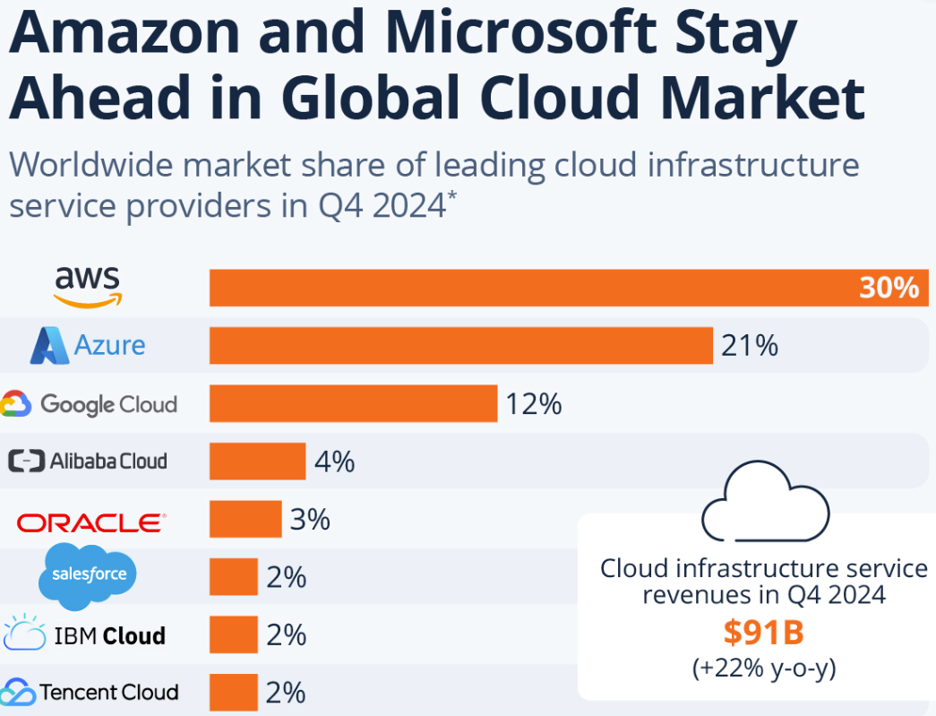
Cloud Market Forecast
SJW
Notes:
Table 13.1 lists some of the relative strengths and weaknesses of the four cloud deployment models.

Slide 16
Cloud Computing
N I S T S P-500-292 (N I S T Cloud Computing Reference Architecture) establishes reference architecture, described as follows:
“The N I S T cloud computing reference architecture focuses on the requirements of “what” cloud services provide, not a “how to” design solution and implementation. The reference architecture is intended to facilitate the understanding of the operational intricacies in cloud computing. It does not represent the system architecture of a specific cloud computing system; instead it is a tool for describing, discussing, and developing a system-specific architecture using a common framework of reference.”
Notes:
N I S T S P 500-292 (N I S T Cloud Computing Reference Architecture, September 2011) establishes reference architecture, described as follows:
The N I S T cloud computing reference architecture focuses on the requirements of “what” cloud services provide, not a “how to” design solution and implementation. The reference architecture is intended to facilitate the understanding of the operational intricacies in cloud computing. It does not represent the system architecture of a specific cloud computing system; instead it is a tool for describing, discussing, and developing a system-specific architecture using a common framework of reference.

Slide 17
Objectives
N I S T developed the reference architecture with the following objectives in mind:
To illustrate and understand the various cloud services in the context of an overall cloud computing conceptual model
To provide a technical reference for Cloud service Consumers (C S C s) to understand, discuss, categorize, and compare cloud services
To facilitate the analysis of candidate standards for security, interoperability, and portability and reference implementations
SJW
Notes:
N I S T developed the reference architecture with the following objectives in mind:
• To illustrate and understand the various cloud services in the context of an overall cloud computing conceptual model
• To provide a technical reference for C S C s to understand, discuss, categorize, and compare cloud services
• To facilitate the analysis of candidate standards for security, interoperability, and portability and reference implementations.

Slide 18
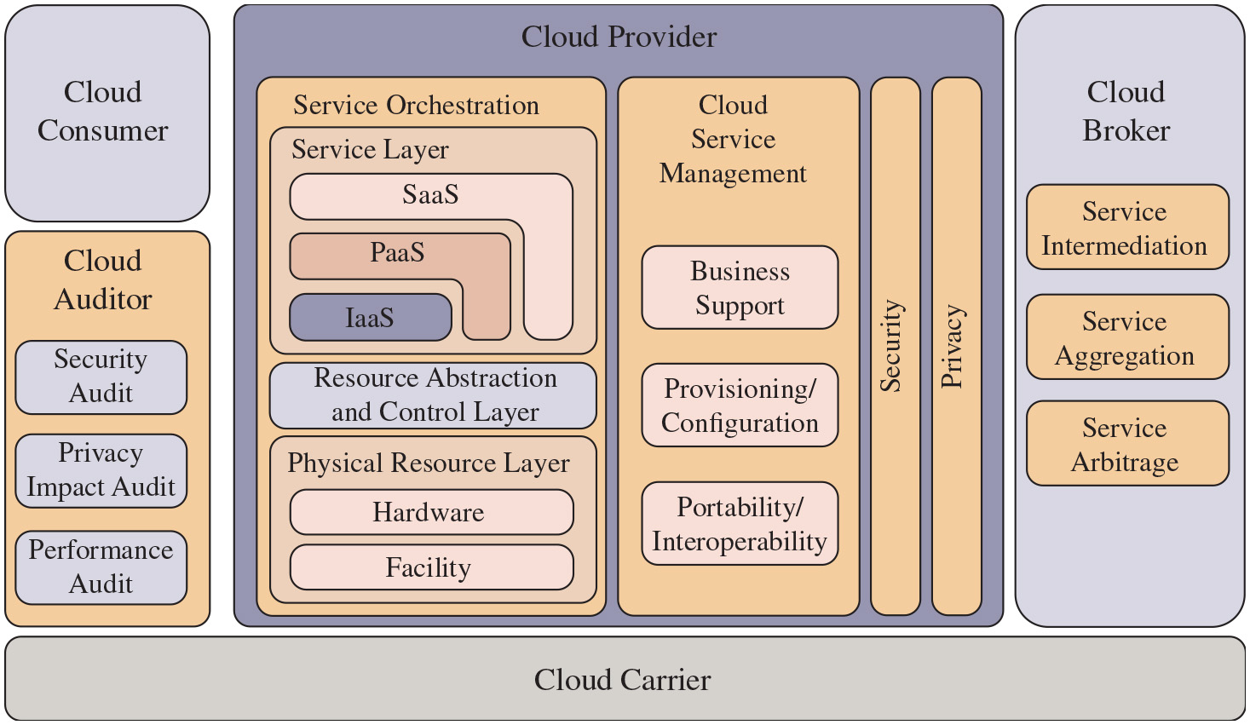
Figure 13.3
N I S T Cloud Computing Reference Architecture
Cloud auditor can help enforce Service Level Agreement (SLA); as an example, think of the requirements of a call center customer
SJW
Notes:
The reference architecture, depicted in Figure 13.3, defines five major actors in terms of the roles and responsibilities:
• Cloud service consumer (C S C): A person or organization that maintains a business relationship with, and uses service from, cloud providers.
• Cloud service provider (C S P): A person, organization, or entity responsible for making a service available to interested parties.
• Cloud auditor: A party that can conduct independent assessment of cloud services, information system operations, performance, and security of the cloud implementation.
• Cloud broker: An entity that manages the use, performance, and delivery of cloud services, and negotiates relationships between C S P s and cloud consumers.
• Cloud carrier: An intermediary that provides connectivity and transport of cloud services from C S P s to cloud consumers.
The roles of the cloud consumer and provider have already been discussed. To summarize, a cloud service provider can provide one or more of the cloud services to meet I T and business requirements of cloud service consumers. For each of the three service models (S a a S, P a a S, I a a S), the C S P provides the storage and processing facilities needed to support that service model together with a cloud interface for cloud service consumers. For S a a S, the C S P deploys, configures, maintains, and updates the operation of the software applications on a cloud infrastructure so that the services are provisioned at the expected service levels to cloud consumers. The consumers of S a a S can be organizations that provide their members with access to software applications, end users who directly use software applications, or software application administrators who configure applications for end users. For P a a S, the C S P manages the computing infrastructure for the platform and runs the cloud software that provides the components of the platform, such as runtime software execution stacks, databases, and other middleware components. Cloud consumers of P a a S can employ the tools and execution resources provided by C S P s to develop, test, deploy, and manage the applications hosted in a cloud environment.
For IaaS, the C S P acquires the physical computing resources underlying the service, including the servers, networks, storage, and hosting infrastructure. The I a a S C S C in turn uses these computing resources, such as a virtual machine, for their fundamental computing needs.
The cloud carrier is a networking facility that provides connectivity and transport of cloud services between cloud consumers and C S P s. Typically, a C S P will set up service level agreements (S L A s) with a cloud carrier to provide services consistent with the level of S L A s offered to cloud consumers, and may require the cloud carrier to provide dedicated and secure connections between cloud consumers and C S P s.
A cloud broker is useful when cloud services are too complex for a cloud consumer to easily manage. A cloud broker can offer three areas of support:
• Service intermediation: These are value-added services such as identity management, performance reporting, and enhanced security.
• Service aggregation: The broker combines multiple cloud services to meet consumer needs not specifically addressed by a single C S P or to optimize performance or minimize cost.
• Service arbitrage: This is similar to service aggregation except that the services being aggregated are not fixed. Service arbitrage means a broker has the flexibility to choose services from multiple agencies. The cloud broker, for example, can use a credit-scoring service to measure and select an agency with the best score.
A cloud auditor can evaluate the services provided by a C S P in terms of security controls, privacy impact, performance, and so on. The auditor is an independent entity that can assure that the C S P conforms to a set of standards. The major actors are as follows. Cloud consumer, cloud carrier, cloud provider, cloud auditor, and cloud broker. The roles and responsibilities are as follows. Cloud auditor. Security audit, privacy impact audit, and performance audit. Cloud provider has four key components. Security, privacy, cloud service management, and service orchestration. Service orchestration includes, service layer with S a a S, P a a S, I a a S, resource abstraction and control layer, and physical resource layer with hardware and facility. Cloud service management has business support, provisioning or configuration, and portabiity or interoperability. Cloud broker includes, service intermediation, service aggregation, and service arbitrage.
Long Description:
The system is built on the cloud carrier, and it consist of the cloud provider, cloud consumer, and cloud broker. The cloud provider has 4 components. Service orchestration, cloud service management, security, and privacy. Service orchestration consists of the service layer, the resource abstraction and control layer, and the physical resource layer. The service layer contains the nested structure of the I a a S, P a a S, and S a a S, and the physical resource layer includes hardware and facility. Cloud service management involves business support, provisioning or configuration, and portability or interoperability. Outside of the cloud provider, the cloud consumer depends on the cloud auditor, which conducts security audit, privacy impact audit, and performance audit. On the other hand, the cloud broker is involved in service intermediation, service aggregation, and service arbitrage.

Slide 19
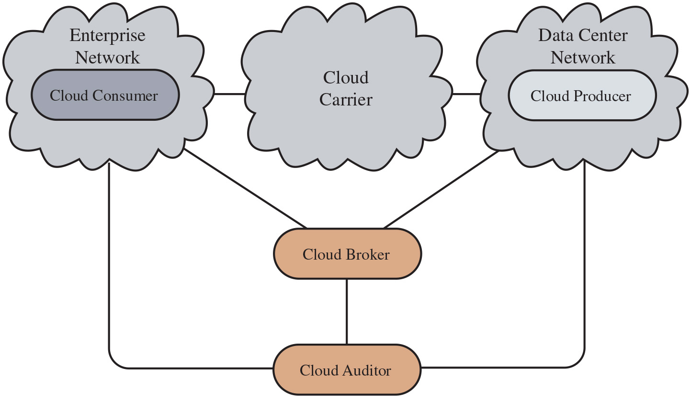
Figure 13.4
Interactions Between Actors in Cloud Computing
Cloud Provider
SJW
Notes:
Figure 13.4 illustrates the interactions between the actors. A cloud consumer may request cloud services from a cloud provider directly or via a cloud broker. A cloud auditor conducts independent audits and may contact the others to collect necessary information. This figure shows that cloud networking issues involve three separate types of networks. For a cloud producer, the network architecture is that of a typical large datacenter, which consists of racks of high-performance servers and storage devices interconnected with high-speed top-of-rack Ethernet switches. The concerns in this context focus on virtual machine placement and movement, load balancing, and availability issues. The enterprise network is likely to have a quite different architecture, typically including a number of L A N s, servers, workstations, P C s, and mobile devices with a broad range of network performance, security, and management issues. The concern of both producer and consumer with respect to the cloud carrier, which is shared with many users, is the ability to create virtual networks, with appropriate S L A and security guarantees. The key actors are as follows. Enterprise network cloud consumer, cloud carrier, data center network cloud producer, cloud broker, and cloud auditor. A cloud consumer may request cloud services from a cloud provider directly or via a cloud broker. A cloud auditor conducts independent audits and may contact the others to collect necessary information.
Long Description:
The cloud carrier connects the cloud consumer in the enterprise network, and the cloud producer in the data center network. The cloud broker and auditor interact with the Enterprise network, Data center Network, and each other.

Slide 20

Table 13.2 (1 of 4)
N I S T Guidelines on Cloud Security and Privacy Issues and Recommendations
Governance
Extend organizational practices pertaining to the policies, procedures, and standards used for application development and service provisioning in the cloud as well as the design, implementation, testing, use, and monitoring of deployed or engaged services.
Put in place audit mechanisms and tools to ensure organizational practices are followed throughout the system life cycle.
Compliance
Understand the various types of laws and regulations that impose security and privacy obligations on the organization and potentially impact cloud computing initiatives, particularly those involving data location, privacy and security controls, records management, and electronic discovery requirements.
Review and assess the cloud provider’s offerings with respect to the organizational requirements to be met and ensure that the contract terms adequately meet the requirements.
Ensure that the cloud provider’s electronic discovery capabilities and processes do not compromise the privacy or security of data and applications.
Australian Signals Directorate
SJW
Notes:
There are numerous aspects to cloud security and numerous approaches to providing cloud security measures. A good example of the scope of cloud security concerns and issues is seen in the N I S T guidelines for cloud security, specified in N I S T S P 800-144 (Guidelines on Security and Privacy in Public Cloud Computing, December 2011) and listed in Table 13.2. Thus, a full discussion of cloud security is well beyond the scope of this chapter.

Slide 21
Table 13.2 (2 of 4)
N I S T Guidelines on Cloud Security and Privacy Issues and Recommendations
Trust
Ensure that service arrangements have sufficient means to allow visibility into the security and privacy controls and processes employed by the cloud provider and their performance over time.
Establish clear, exclusive ownership rights over data.
Institute a risk management program that is flexible enough to adapt to the constantly evolving and shifting risk landscape for the life cycle of the system.
Continuously monitor the security state of the information system to support ongoing risk management decisions.
Architecture
Understand the underlying technologies that the cloud provider uses to provision services, including the implications that the technical controls involved have on the security and privacy of the system over the full system lifecycle and across all system components.

Slide 22
Table 13.2 (3 of 4)
N I S T Guidelines on Cloud Security and Privacy Issues and Recommendations
Identity and access management
Ensure that adequate safeguards are in place to secure authentication, authorization, and other identity and access management functions and are suitable for the organization.
Software isolation
Understand virtualization and other logical isolation techniques that the cloud provider employs in its multi-tenant software architecture, and assess the risks involved for the organization.
Data protection
Evaluate the suitability of the cloud provider’s data management solutions for the organizational data concerned and the ability to control access to data; to secure data while at rest, in transit, and in use; and to sanitize data.
Take into consideration the risk of collating organizational data with those of other organizations whose threat profiles are high or whose data collectively represent significant concentrated value.
Fully understand and weigh the risks involved in cryptographic key management with the facilities available in the cloud environment and the processes established by the cloud provider.

Slide 23
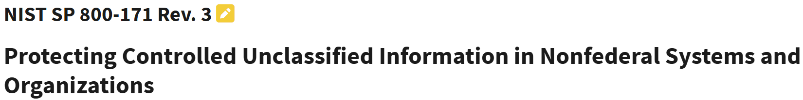
Table 13.2 (4 of 4)
N I S T Guidelines on Cloud Security and Privacy Issues and Recommendations
Availability
Understand the contract provisions and procedures for availability, data backup and recovery and disaster recovery, and ensure that they meet the organization’s continuity and contingency planning requirements.
Ensure that during an intermediate or prolonged disruption or a serious disaster, critical operations can be immediately resumed, and that all operations can be eventually reinstituted in a timely and organized man
Incident response
Understand the contract provisions and procedures for incident response, and ensure that they meet the requirements of the organization.
Ensure that the cloud provider has a transparent response process in place and sufficient mechanisms to share information during and after an incident.
Ensure that the organization can respond to incidents in a coordinated fashion with the cloud provider in accordance with their respective roles and responsibilities for the computing environment.
SJW

Slide 24
Security Issues for Cloud Computing
Security is a major consideration when augmenting or replacing on-premises systems with cloud services
Allaying security concerns is frequently a prerequisite for further discussions about migrating part or all of an organization’s computing architecture to the cloud
Availability is another major concern
Auditability of data must be ensured
Businesses should perform due diligence on security threats both from outside and inside the cloud
Cloud users are responsible for application-level security
Cloud vendors are responsible for physical security and some software security
Security for intermediate layers of the software stack is shared between users and vendors
Cloud providers must guard against theft or denial-of-service attacks by their users and users need to be protected from one another
Businesses should consider the extent to which subscribers are protected against the provider, especially in the area of inadvertent data loss
Notes:
Security is important to any computing infrastructure. Companies go to great lengths to secure on-premises computing systems, so it is not surprising that security looms as a major consideration when augmenting or replacing on-premises systems with cloud services. Allaying security concerns is frequently a prerequisite for further discussions about migrating part or all of an organization’s computing architecture to the cloud. Availability is another major concern.
Generally speaking, such questions only arise when businesses contemplating moving core transaction processing, such as enterprise resource planning (E R P) systems and other mission critical applications to the cloud. Companies have traditionally demonstrated less concern about migrating high-maintenance applications such as e-mail and payroll to cloud service providers even though such applications hold sensitive information.
Auditability is another concern for many organizations. For example, in the United States, many organizations must comply with Sarbanes-Oxley and/or Health and Human Services Health Insurance Portability and Accountability Act (H I P A A) regulations. The auditability of their data must be ensured whether it is stored on premises or moved to the cloud.
Before moving critical infrastructure to the cloud, businesses should perform due diligence on security threats both from outside and inside the cloud. Many of the security issues associated with protecting clouds from outside threats are similar to those that have traditionally faced centralized data centers. In the cloud, however, responsibility for assuring adequate security is frequently shared among users, vendors, and any third-party firms that users rely on for security-sensitive software or configurations. Cloud users are responsible for application-level security. Cloud vendors are responsible for physical security and some software security such as enforcing external firewall policies. Security for intermediate layers of the software stack is shared between users and vendors. A security risk that should not be overlooked by companies considering a migration to the cloud is that posed by sharing vendor resources with other cloud users. Cloud providers must guard against theft or denial-of-service attacks by their users and users need to be protected from one another. Virtualization can be a powerful mechanism for addressing these potential risks because it protects against most attempts by users to attack one another or the provider’s infrastructure. However, not all resources are virtualized, and not all virtualization environments are bug free. Incorrect virtualization may allow user code to access to sensitive portions of the provider’s infrastructure or the resources of other users. Once again, these security issues are not unique to the cloud and are similar to those involved in managing non-cloud data centers where different applications need to be protected from one another.
Another security concern that businesses should consider is the extent to which subscribers are protected against the provider, especially in the area of inadvertent data loss. For example, in the event of provider infrastructure improvements, what happens to hardware that is retired or replaced? It is easy to imagine a hard disk being disposed of without being properly wiped clean of subscriber data. It is also easy to imagine permissions bugs or errors that make subscriber data visible to unauthorized users. User-level encryption may be an important self-help mechanism for subscribers, but businesses should ensure that other protections are in place to avoid inadvertent data loss.

Slide 25
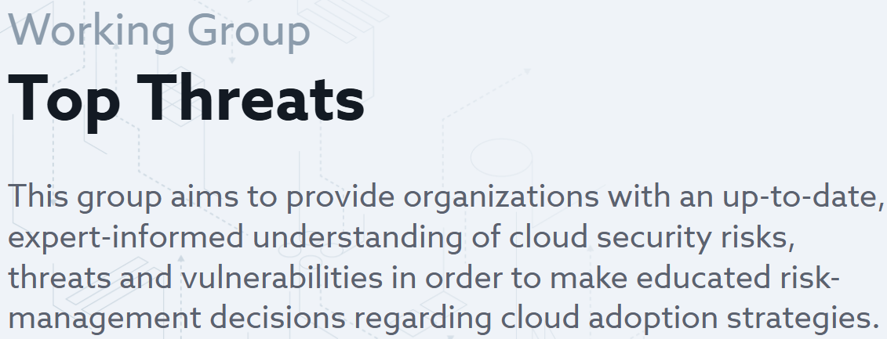
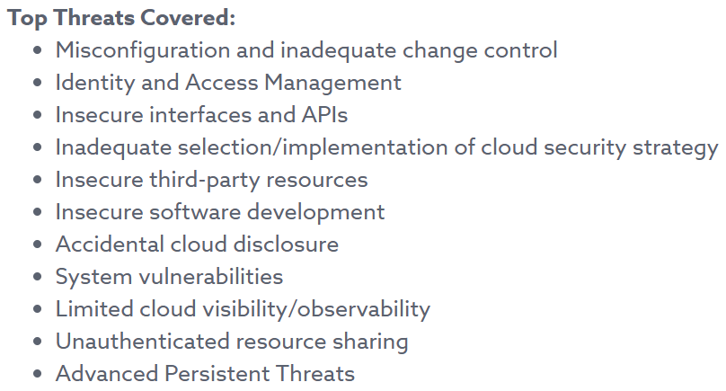
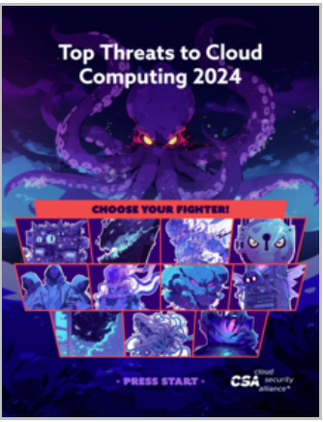
Cloud Security Alliance
SJW
Notes:
Numerous documents have been developed to guide business thinking about the security issues associated with cloud computing. In addition to N I S T S P 800-144, which provides overall guidance, there is also N I S T S P 800-146 (Cloud Computing Synopsis and Recommendations, May 2012). NIST’s recommendations systematically consider each of the major types of cloud services consumed by businesses, including S a a S, I a a S, and P a a S. While security issues vary somewhat depending on the type of cloud service, there are multiple N I S T recommendations that are independent of service type. Not surprisingly, N I S T recommends selecting cloud providers that support strong encryption, have appropriate redundancy mechanisms in place, employ authentication mechanisms, and offer subscribers sufficient visibility about mechanisms used to protect subscribers from other subscribers and the provider. N I S T S P 800-146 also lists the overall security controls that are relevant in a cloud computing environment and that must be assigned to the different cloud actors. These are listed in Table 13.3.
Another useful reference is [A C S C 21 c], which provides a list of cloud computing security considerations that both senior managers and technical staff should
address. This list includes questions that address the following topics:
• Availability of data and business functionality
• Protecting data from unauthorized access
• Handling security incidents
As more businesses incorporate cloud services into their enterprise network infrastructures, cloud computing security will persist as an important issue. Examples of cloud computing security failures have the potential to have a chilling effect on business interest in cloud services. This is inspiring service providers to be serious about incorporating security mechanisms that will allay concerns of potential subscribers. Some service providers have moved their operations to Tier 4 data centers (see Section 5.8) to address user concerns about availability and redundancy. As so many businesses remain reluctant to embrace cloud computing in a big way, cloud service providers will have to continue to work hard to convince potential customers that computing support for core business processes and mission critical applications can be moved safely and securely to the cloud.

Slide 26
Table 13.3
Control Functions and Classes
Technical | Operational | Management
Access Control Audit and Accountability Identification and Authentication System and Communication Protection | Awareness and Training Configuration and Management Contingency Planning Incident Response Maintenance Media Protection Physical and Environmental Protection Personnel Security System and Information Integrity | Certification, Accreditation and Security Assessment Planning Risk Assessment System and Services Acquisition
Notes:
Numerous documents have been developed to guide business thinking about the security issues associated with cloud computing. In addition to N I S T S P 800-144, which provides overall guidance, there is also N I S T S P 800-146 (Cloud Computing Synopsis and Recommendations, May 2012). NIST’s recommendations systematically consider each of the major types of cloud services consumed by businesses, including S a a S, I a a S, and P a a S. While security issues vary somewhat depending on the type of cloud service, there are multiple N I S T recommendations that are independent of service type. Not surprisingly, N I S T recommends selecting cloud providers that support strong encryption, have appropriate redundancy mechanisms in place, employ authentication mechanisms, and offer subscribers sufficient visibility about mechanisms used to protect subscribers from other subscribers and the provider. N I S T S P 800-146 also lists the overall security controls that are relevant in a cloud computing environment and that must be assigned to the different cloud actors. These are listed in Table 13.3.
Another useful reference is [A C S C 21 c], which provides a list of cloud computing security considerations that both senior managers and technical staff should
address. This list includes questions that address the following topics:
• Availability of data and business functionality
• Protecting data from unauthorized access
• Handling security incidents
As more businesses incorporate cloud services into their enterprise network infrastructures, cloud computing security will persist as an important issue. Examples of cloud computing security failures have the potential to have a chilling effect on business interest in cloud services. This is inspiring service providers to be serious about incorporating security mechanisms that will allay concerns of potential subscribers. Some service providers have moved their operations to Tier 4 data centers (see Section 5.8) to address user concerns about availability and redundancy. As so many businesses remain reluctant to embrace cloud computing in a big way, cloud service providers will have to continue to work hard to convince potential customers that computing support for core business processes and mission critical applications can be moved safely and securely to the cloud.

Slide 27
Risks and Countermeasures (1 of 5)
The Cloud Security Alliance lists the following as the top cloud-specific security threats:
Abuse and nefarious use of cloud computing
Countermeasures include:
Stricter initial registration and validation processes
Enhanced credit card fraud monitoring and coordination
Comprehensive inspection of customer network traffic
Monitoring public blacklists for one’s own network blocks
Insecure interfaces and A P I s
Countermeasures include:
Analyzing the security model of C S P interfaces
Ensuring that strong authentication and access controls are implemented in concert with encrypted transmission
Understanding the dependency chain associated with the A P I
Notes:
In general terms, security controls in cloud computing are similar to the security controls in any I T environment. However, because of the operational models and technologies used to enable cloud service, cloud computing may present risks that are specific to the cloud environment. The essential concept in this regard is that, while the enterprise loses a substantial amount of control over resources, services, and applications, it must maintain accountability for security and privacy policies.
The Cloud Security Alliance [C S A 13] lists the following as the top cloud-specific security threats:
• Abuse and nefarious use of cloud computing: For many C S P s, it is relatively easy to register and begin using cloud services, some even offering free limited trial periods. This enables attackers to get inside the cloud to conduct various attacks, such as spamming, malicious code attacks, and denial of service. PaaS providers have traditionally suffered most from this kind of attacks; however, recent evidence shows that hackers have begun to target I a a S vendors as well. The burden is on the C S P to protect against such attacks, but cloud service clients must monitor activity with respect to their data and resources to detect any malicious behavior.
Countermeasures include (1) stricter initial registration and validation processes; (2) enhanced credit card fraud monitoring and coordination; (3) comprehensive inspection of customer network traffic; and (4) monitoring public blacklists for one’s own network blocks.
• Insecure interfaces and APIs: C S P s expose a set of software interfaces or A P I s that customers use to manage and interact with cloud services. The security and availability of general cloud services is dependent upon the security of these basic A P I s. From authentication and access control to encryption and activity monitoring, these interfaces must be designed to protect against both accidental and malicious attempts to circumvent policy.
Countermeasures include (1) analyzing the security model of C S P interfaces; (2) ensuring that strong authentication and access controls are implemented in concert with encrypted transmission; and (3) understanding the dependency chain associated with the A P I.

Slide 28
Risks and Countermeasures (2 of 5)
Malicious insiders
Countermeasures include:
Enforce strict supply chain management and conduct a comprehensive supplier assessment
Specify human resource requirements as part of legal contract
Require transparency into overall information security and management practices, as well as compliance reporting
Determine security breach notification processes
Notes:
• Malicious insiders: Under the cloud computing paradigm, an organization relinquishes direct control over many aspects of security and, in doing so, confers an unprecedented level of trust onto the C S P. One grave concern is the risk of malicious insider activity. Cloud architectures necessitate certain roles that are extremely high risk. Examples include C S P system administrators and managed security service providers.
Countermeasures include the following: (1) enforce strict supply chain management and conduct a comprehensive supplier assessment; (2) specify human resource requirements as part of legal contract; (3) require transparency into overall information security and management practices, as well as compliance reporting; and (4) determine security breach notification processes.

Slide 29
Risks and Countermeasures (3 of 5)
Shared technology issues
Countermeasures include:
Implement security best practices for installation/configuration
Monitor environment for unauthorized changes/activity
Promote strong authentication and access control for administrative access and operations
Enforce S L A s for patching and vulnerability remediation
Conduct vulnerability scanning and configuration audits
Notes:
Shared technology issues: I a a S vendors deliver their services in a scalable way by sharing infrastructure. Often, the underlying components that make up this infrastructure (C P U caches, G P U s, etc.) were not designed to offer strong isolation properties for a multi-tenant architecture. C S P s typically approach this risk by using isolated VMs for individual clients. This approach is still vulnerable to attack by both insiders and outsiders, and so can only be a part of an overall security strategy.
Countermeasures include the following: (1) implement security best practices for installation/configuration; (2) monitor environment for unauthorized changes/activity; (3) promote strong authentication and access control for administrative access and operations; (4) enforce SLAs for patching and vulnerability remediation; and (5) conduct vulnerability scanning and configuration audits.

Slide 30
Risks and Countermeasures (4 of 5)
Data loss or leakage
Countermeasures include:
Implement strong A P I access control
Encrypt and protect integrity of data in transit and at rest
Analyze data protection at both design and run time
Implement strong key generation, storage and management, and destruction practices
Account or service hijacking
Countermeasures include:
Prohibit the sharing of account credentials between users and services
Leverage strong two-factor authentication techniques where possible
Employ proactive monitoring to detect unauthorized activity
Understand C S P security policies and S L A s
Notes:
Data loss or leakage: For many clients, the most devastating impact from a security breach is the loss or leakage of data. We will address this issue in the next section.
Countermeasures include the following: (1) implement strong A P I access control; (2) encrypt and protect integrity of data in transit and at rest; (3) analyze data protection at both design and run time; and (4) implement strong key generation, storage and management, and destruction practices.
• Account or service hijacking: Account and service hijacking, usually with stolen credentials, remains a top threat. With stolen credentials, attackers can often access critical areas of deployed cloud computing services, allowing them to compromise the confidentiality, integrity, and availability of those services.
Countermeasures include the following: (1) prohibit the sharing of account credentials between users and services; (2) leverage strong two-factor authentication techniques where possible; (3) employ proactive monitoring to detect unauthorized activity; and (4) understand C S P security policies and S L A s.

Slide 31
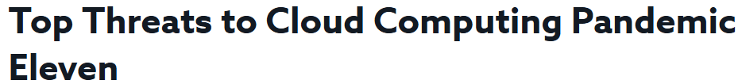
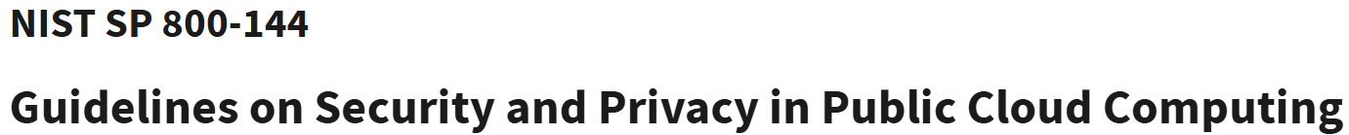
Risks and Countermeasures (5 of 5)
Unknown risk profile (since client cedes control to the cloud provider )
Countermeasures include:
Disclosure of applicable logs and data
Partial/full disclosure of infrastructure details
Monitoring and alerting on necessary information
SJW
Notes:
• Unknown risk profile: In using cloud infrastructures, the client necessarily cedes control to the cloud provider on a number of issues that may affect security. Thus, the client must pay attention to and clearly define the roles and responsibilities involved for managing risks. For example, employees may deploy applications and data resources at the C S P without observing the normal policies and procedures for privacy, security, and oversight.
Countermeasures include (1) disclosure of applicable logs and data; (2) partial/full disclosure of infrastructure details (e.g., patch levels and firewalls); and (3) monitoring and alerting on necessary information.
The Cloud Security Alliance continue updating this list, with their most recent report detailing the “Pandemic Eleven” [C S A 22]. Similar lists have been developed
by the European Network and Information Security Agency [E N I S 09] and N I S T S P 800-144. The topic is also explored further in [S T A L 19].

Slide 32

Data Protection in the Cloud (1 of 2)
The threat of data compromise increases in the cloud due to the number of and interactions between risks and challenges that are either unique to the cloud or more dangerous because of the architectural or operational characteristics of the cloud environment
Even with these precautions, corruption and other denial-of-service attacks remain a risk
Data must be secured while at rest, in transit, and in use, and access to the data must be controlled
For data at rest, the ideal security measure is for the client to encrypt the database and only store encrypted data in the cloud with the C S P having no access to the encryption key
The client can employ encryption to protect data in transit, though this involves key management responsibilities for the C S P
The client can enforce access control techniques, but C S P is involved to some extent depending on the service model used
Notes:
There are many ways to compromise data. Deletion or alteration of records without a backup of the original content is an obvious example. Unlinking a record from a larger context may render it unrecoverable as can storage on unreliable media. Loss of an encoding key may result in effective destruction. Finally, unauthorized parties must be prevented from gaining access to sensitive data.
The threat of data compromise increases in the cloud due to the number of and interactions between risks and challenges that are either unique to the cloud or more dangerous because of the architectural or operational characteristics of the cloud environment.
Data must be secured while at rest, in transit, and in use, and access to the data must be controlled. The client can employ encryption to protect data in transit, though this involves key management responsibilities for the C S P. The client can enforce access control techniques, but, again, the C S P is involved to some extent depending on the service model used.
For data at rest, the ideal security measure is for the client to encrypt the database and only store encrypted data in the cloud with the C S P having no access to the encryption key. So long as the key remains secure, the C S P has no ability to decipher the data, although corruption and other denial-of-service attacks remain a risk. The model depicted in Figure 5.9 works equally well when the data is stored in a cloud.

Slide 33
Data Protection in the Cloud (2 of 2)
Multi-instance Model
Provides a unique D B M S running on a V M instance for each cloud subscriber
This gives the subscriber complete control over role definition, user authorization, and other administrative tasks related to security
Multi-tenant Model
Provides a predefined environment for the cloud subscriber that is shared with other tenants, typically through tagging data with a subscriber identifier
Tagging gives the appearance of exclusive use of the instance, but relies on the cloud provider to establish and maintain a sound secure database environment
Notes:
Database environments used in cloud computing can vary significantly. Some providers support a multi-instance model, which provide a unique D B M S running on a V M instance for each cloud subscriber. This gives the subscriber complete control over role definition, user authorization, and other administrative tasks related to security. Other providers support a multi-tenant model, which provides a predefined environment for the cloud subscriber that is shared with other tenants, typically through tagging data with a subscriber identifier. Tagging gives the appearance of exclusive use of the instance, but relies on the cloud provider to establish and maintain a sound secure database environment.

Slide 34
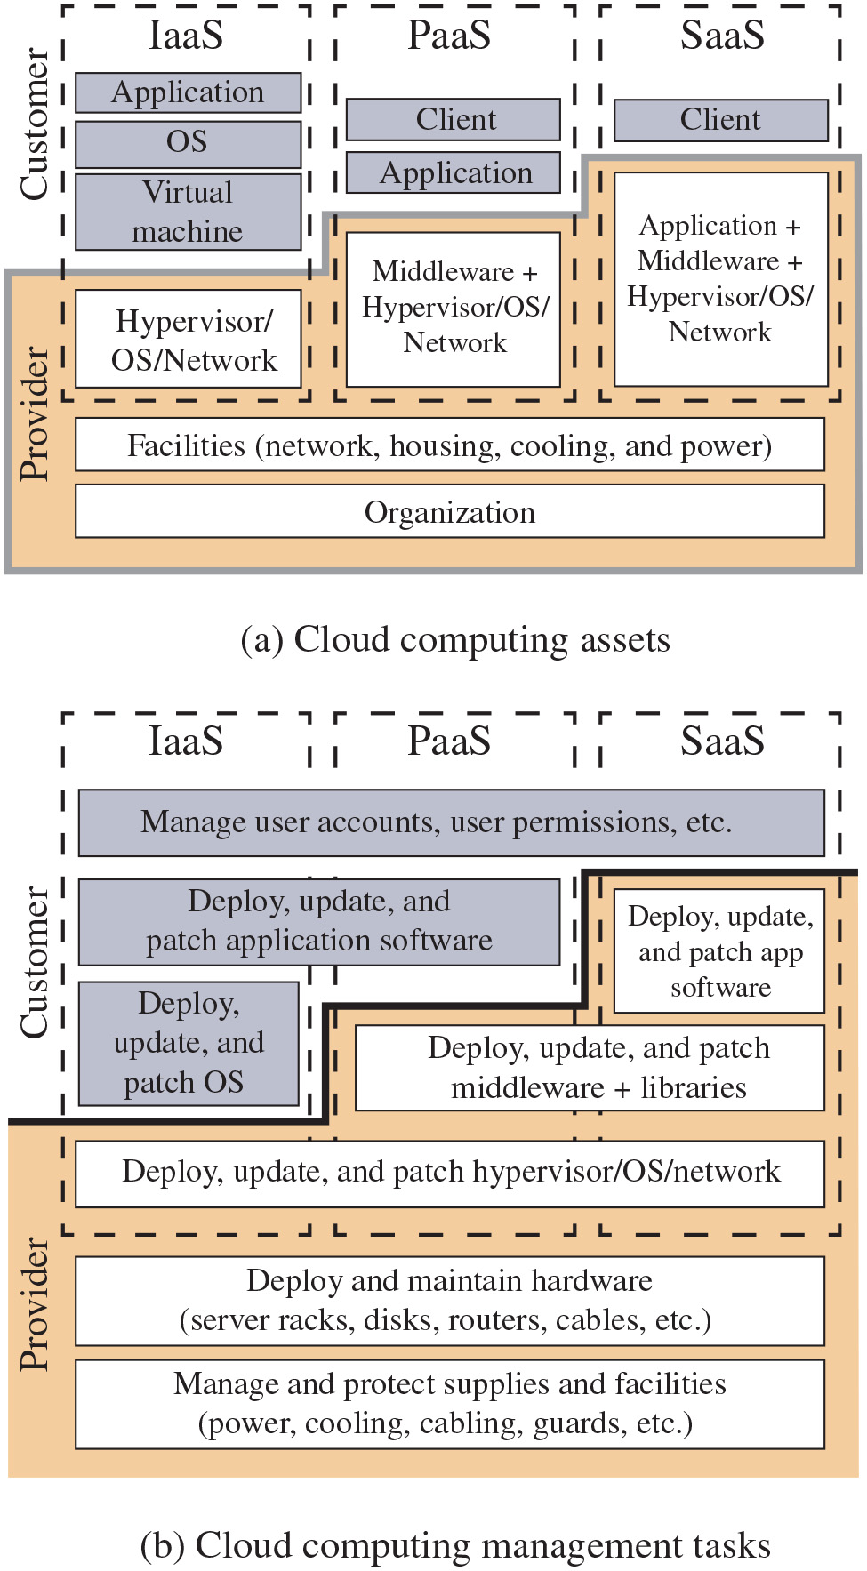
Figure 13.5
Security Considerations for Cloud Computing Assets
Notes:
Beyond the protection and isolation of data, the cloud service provider (C S P) needs to address the broader security considerations for the protection of its assets. Figure 13.5a, adapted from [E N I S 15], suggests a categorization of these assets for the three cloud service models. The bottom two layers shown in the figure include organization and facilities. Organization denotes the human resources and the policies and procedures for maintaining the facilities and supporting the delivery of the services. Facilities denote the physical structures and supplies such as networks, cooling, and power supply. Above these levels are the assets specific to the provision of services. For I a a S, the C S P maintains a hypervisor and/or O S on each of its servers, as well as the networking software for interconnection of C S P servers and connection to cloud service consumers (C S C s). Added to these assets for PaaS are the libraries, middleware, and other software to support C S C applications. For S a a S, the C S P also has application software assets for C S C use.
Figure 13.5b suggests key security tasks that are the responsibility of the C S P and of the C S C. The lowest level of the diagram has to do with organizational issues related to the management of its supplies and facilities. These issues will be dealt with in Chapters 14, 15, and 17. The next level of Figure 13.5b covers the physical security of the facility, a topic covered in Chapter 16. Above that, depending on the service model, the C S P is responsible for the security of a range of software capabilities; security measures in the area were addressed in Chapters 11 and 12. The first diagram illustrates the categorization of the assets for the three cloud service models. The bottom two layers shown in the figure include organization and facilities. Organization denotes the human resources and the policies and procedures for maintaining the facilities and supporting the delivery of the services. Facilities denote the physical structures and supplies such as networks, cooling, and power supply. Above these levels are the assets specific to the provision of services. For I a a S, the C S P maintains a hypervisor and or O S on each of its servers, as well as the networking software for interconnection of C S P servers and connection to cloud service consumers, C S Cs. Added to these assets for P a a S are the libraries, middleware, and other software to support C S C applications. For S a a S, the C S P also has application software assets for C S C use. The second diagram illustrates the key security tasks that are the responsibility of the C S P and of the C S C. The lowest level of the diagram has to do with organizational issues related to the management of its supplies and facilities. The next level depicts the physical security of the facility, and above that, depending on the service model, the C S P is responsible for the security of a range of software capabilities, and security measures in the area.
Long Description:
Part (a): Cloud computing assets. Within the provider, Facilities (network, housing, cooling, and power) are stacked on the organization. The I a a S, P a a S, and S a a S are all stacked on the facilities, with different components attributed to the provider and the customer. For each model, the following list provides the provider components and then the customer components. I a a S. Provider, hypervisor or O S or network. Customer, virtual machine, O S, and application. P a a S. Provider, middleware plus hypervisor or O S or network. Customer, application, client. S a a S. Provider, application plus middleware plus hypervisor or O S or network. Customer, client. Part (b): Cloud computing management tasks. In the cloud computing model, the provider manages and protects supplies and facilities, including power, cooling, cabling, and guards, and the provider side of the I a a S, P a a S, and S a a S deploy, update, and patch the hypervisor or O S or and network. Provider-side portions of the P a a S and S a a S deploy, update, and patch middleware plus libraries, and the provider-side portion of the S a a S deploys, updates, and patches application software. Otherwise customer-side portions of the I a a S model handles deploy, update and patch O S. The I a a S and P a a S portions deploy, update, an patch application software. All the three Manage user accounts, user permissions, etc.

Slide 35
Cloud Security as a Service
In the context of cloud computing, cloud security as a service, designated SecaaS, is a segment of the SaaS offering of a C S P
The C S A defines SecaaS as the provision of security applications and services via the cloud either to cloud-based infrastructure and software, or from the cloud to the customers’ on-premise systems
The C S A has identified the following SecaaS categories of service:
Identity and access management
Data loss prevention
Web security
E-mail security
Security assessments
Intrusion management
Security information and event management
Encryption
Business continuity and disaster recovery
Network security
You can’t bolt on security, but’s that’s what the SecaaS sellers want you to think
SJW
Notes:
The term security as a service has generally meant a package of security services offered by a service provider that offloads much of the security responsibility from an enterprise to the security service provider. Among the services typically provided are authentication, anti-virus, anti-malware/spyware, intrusion detection, and security event management. In the context of cloud computing, cloud security as a service, designated SecaaS, is a segment of the SaaS offering of a C S P.
The C S A defines SecaaS as the provision of security applications and services via the cloud either to cloud-based infrastructure and software or from the cloud to the customers’ on-premise systems [C S A 16]. The C S A has identified the following SecaaS categories of service:
• Identity and access management
• Data loss prevention
• Web security
• E-mail security
• Security assessments
• Intrusion management
• Security information and event management
• Encryption
• Business continuity and disaster recovery
• Network security

Slide 36
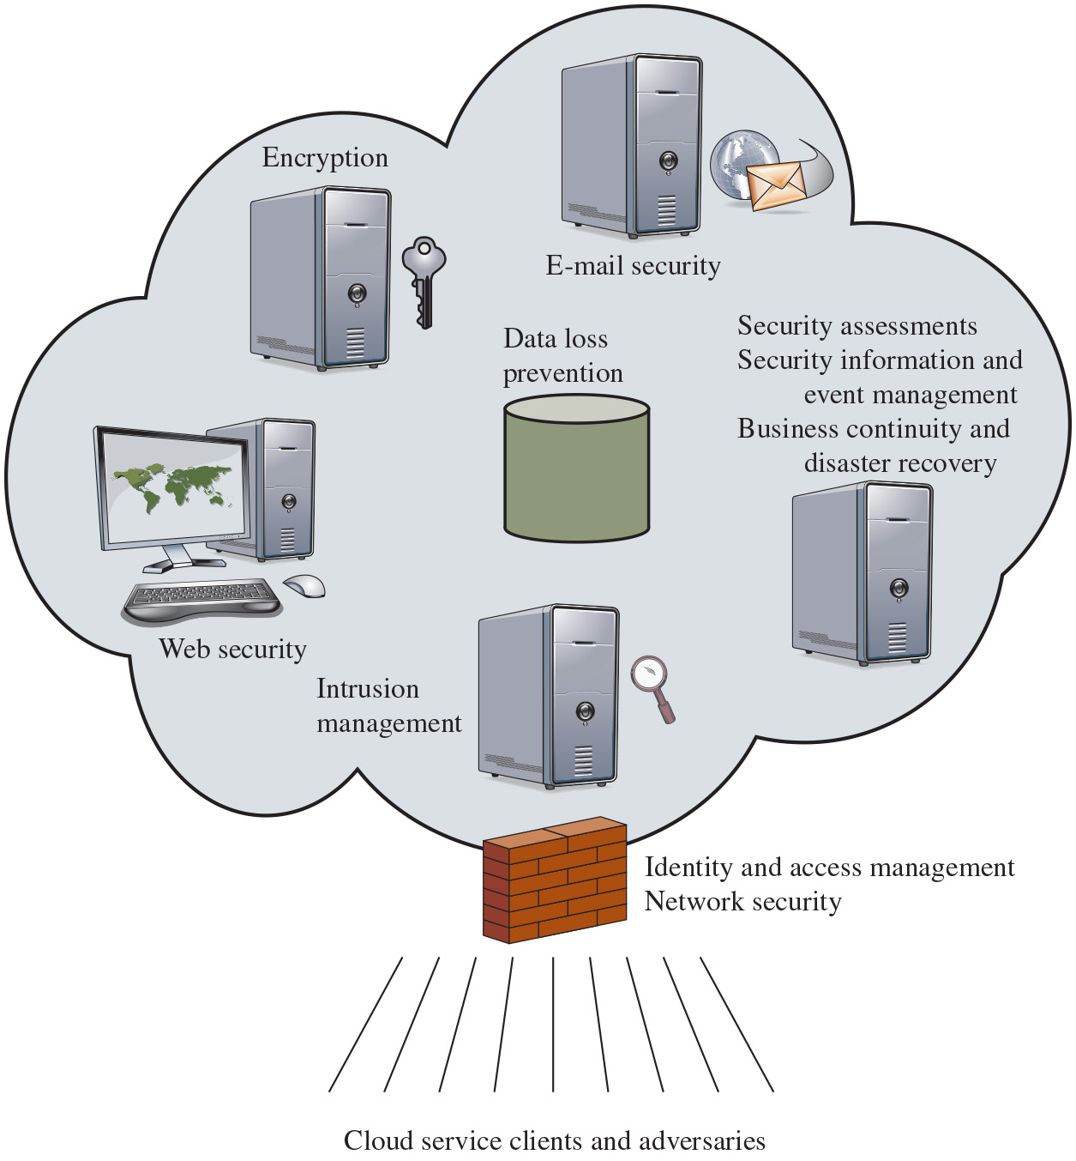
Figure 13.6
Elements of Cloud Security as a Service
Notes:
In this section, we examine these categories with a focus on security of the cloud-based infrastructure and services (see Figure 13.6).
Identity and access management (I A M) includes people, processes, and systems that are used to manage access to enterprise resources by assuring that the identity of an entity is verified, then granting the correct level of access based on this assured identity. One aspect of identity management is identity provisioning, which has to do with providing access to identified users and subsequently deprovisioning, or denying access, to users when the client enterprise designates such users as no longer having access to enterprise resources in the cloud. Among other requirements, the cloud service provider must be able to exchange identity attributes with the enterprise’s chosen identity provider.
The access management portion of I A M involves authentication and access control services. For example, the C S P must be able to authenticate users in a trustworthy manner. The access control requirements in S P I environments include establishing trusted user profile and policy information, using it to control access within the cloud service, and doing this in an auditable way.
Data loss prevention (D L P) is the monitoring, protecting, and verifying the security of data at rest, in motion, and in use. Much of D L P can be implemented by the cloud client, such as discussed previously in this section (Data Protection in the Cloud). The C S P can also provide D L P services, such as implementing rules about what functions can be performed on data in various contexts.
Web security is real-time protection offered either on premise through software/ appliance installation or via the cloud by proxying or redirecting Web traffic to the C S P. This provides an added layer of protection on top of things like antiviruses to prevent malware from entering the enterprise via activities such as Web browsing. In addition to protecting against malware, a cloud-based Web security service might include usage policy enforcement, data backup, traffic control, and Web access control.
A C S P may provide a Web-based e-mail service for which security measures are needed. E-mail security provides control over inbound and outbound e-mail, protecting the organization from phishing and malicious attachments, and enforcing corporate polices such as acceptable use and spam prevention. The C S P may also incorporate digital signatures on all e-mail clients and provide optional e-mail encryption.
Security assessments are third-part audits of cloud services. While this service is outside the province of the C S P, the C S P can provide tools and access points to facilitate various assessment activities.
Intrusion management encompasses intrusion detection, prevention, and response. The core of this service is the implementation of intrusion detection systems (I D S s) and intrusion prevention systems (I P S s) at entry points to the cloud and on servers in the cloud. An I D S is a set of automated tools designed to detect unauthorized access to a host system. An I P S incorporates I D S functionality and in addition includes mechanisms designed to block traffic from intruders.
Security information and event management (S I E M) aggregates (via push or pull mechanisms) log and event data from virtual and real networks, applications, and systems. This information is then correlated and analyzed to provide real-time reporting and alerting on information/events that may require intervention or other type of response. The C S P typically provides an integrated service that can put together information from a variety of sources both within the cloud and within the client enterprise network.
Encryption is a pervasive service that can be provided for data at rest in the cloud, e-mail traffic, client-specific network management information, and identity information. Encryption services provided by the C S P involve a range of complex issues, including key management, how to implement virtual private network (V P N) services in the cloud, application encryption, and data content access.
Business continuity and disaster recovery comprise measures and mechanisms to ensure operational resiliency in the event of any service interruptions. This is an area where the C S P, because of economies of scale, can offer obvious benefits to a cloud service client. The C S P can provide backup at multiple locations with reliable failover and disaster recovery facilities. This service must include a flexible infrastructure, redundancy of functions and hardware, monitored operations, geographically distributed data centers, and network survivability.
Network security consists of security services that allocate access, distribute, monitor, and protect the underlying resource services. Services include perimeter and server firewalls and denial-of-service protection. Many of the other services listed in this section, including intrusion management, identity and access management, data loss protection, and Web security, also contribute to the network security service. The elements are as follows. Identity and access management, data loss prevention, web security, security assessments, intrusion management, security information and event management, encryption, business continuity and disaster recovery, and network security.
Long Description:
A cloud consists of the following in clockwise direction: A server with a key labeled Encryption. A server with a inward coming mail around a globe icon labeled Email security. Security assessments, Security information and event management Business continuity and disaster recovery. A server labeled Intrusion management. A desktop labeled Web security, all around a cylinder labeled data loss prevention. A wall of brick labeled Identity and access management network security, at the bottom of the cloud, with outward expanding lines labeled Cloud service clients and adversaries.

Slide 37
Cloud Security Practical Defenses
Prevent cross-tenant data or access leakage:
Cloud providers: keep your hypervisors up to date, ensure correct settings, apply network isolation techniques (e.g. VLANs)
Customers: use reputable providers that do the above, ensure correct settings
Prevent access rights issues:
Set your access rights as restrictively as possible from the start
Monitor access rights over time (there’s software for this)
Prevent cloud command-and-control issues:
Secure credentials
Set service usage notices and pay caps
Mitigate the fact the cloud provider has access to all your data:
Don’t use the cloud’s storage services
Encrypt the data before it hits the cloud (if possible)
Don’t use cloud at all...
SJW
Source: http://people.duke.edu/~tkb13/courses/ece590-sec-2019fa/slides/12-cloud.pdf

Slide 38
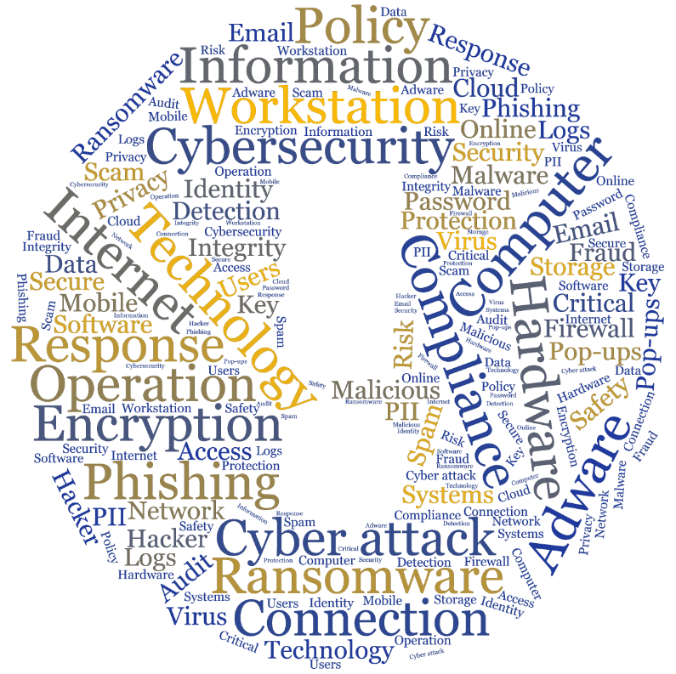
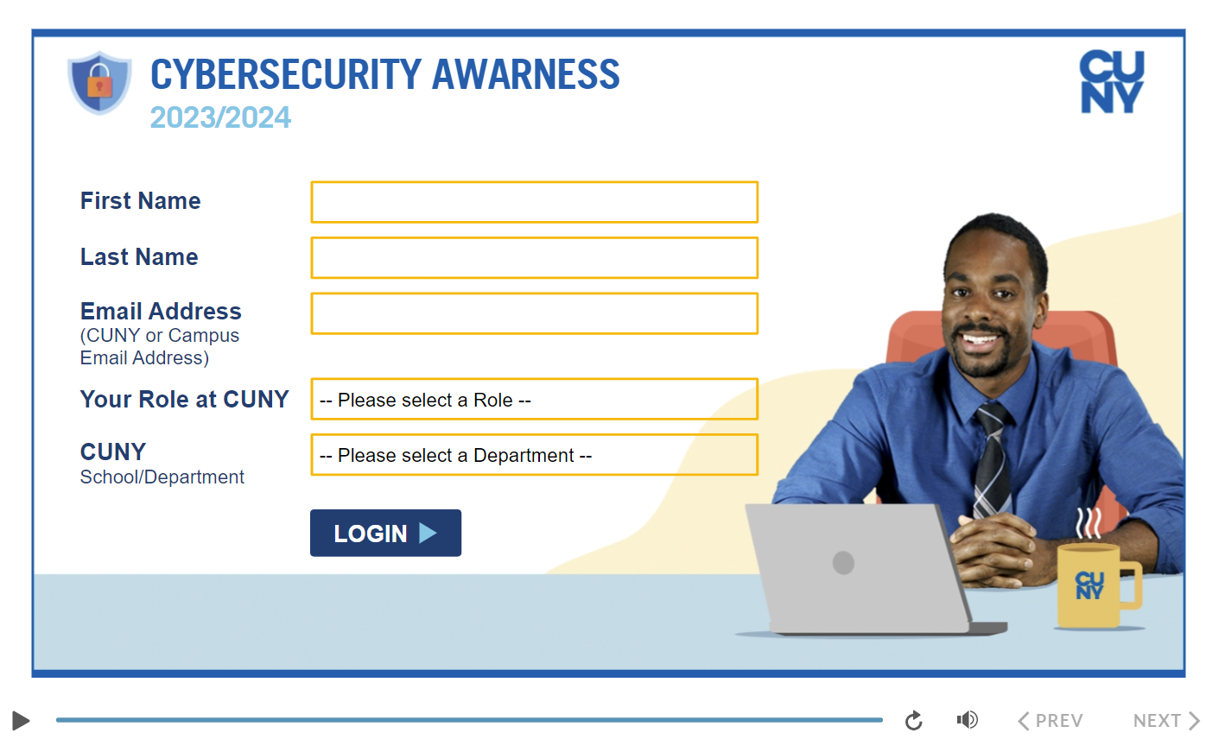
Required Cybersecurity Awareness Training for Employees at CUNY
Required for faculty and staff as of April 30, 2024
Acceptable Use of University Data in the Cloud
Available on Brightspace
SJW

Slide 39
OpenStack (1 of 2)
Open-source software project of the OpenStack Foundation that aims to produce an open-source cloud operating system
The principal objective is to enable creating and managing huge groups of virtual private servers in a cloud computing environment
OpenStack is embedded, to one degree or another, into data center infrastructure and cloud computing products
It provides multi-tenant I a a S and aims to meet the needs of public and private clouds, regardless of size, by being simple to implement and massively scalable
Notes:
This section provides an overview of an open-source security module that is part of the OpenStack cloud O S. OpenStack is an open-source software project of the OpenStack Foundation that aims to produce an open-source cloud operating system [R O S A 14, S E F R 12]. The principal objective is to enable creating and managing huge groups of virtual private servers in a cloud computing environment. OpenStack is embedded, to one degree or another, into data center infrastructure and cloud computing products offered by Cisco, I B M, Hewlett-Packard, and other vendors. It provides multi-tenant I a a S and aims to meets the needs of public and private clouds regardless of size, by being simple to implement and massively scalable.

Slide 40
OpenStack (2 of 2)
The OpenStack O S consists of a number of independent modules, each of which has a project name and a functional name
The security module for OpenStack is Keystone
Keystone provides the shared security services essential for a functioning cloud computing infrastructure
It provides the following main services:
Identity
Token
Service catalog
Policies
Notes:
The OpenStack O S consists of a number of independent modules, each of which has a project name and a functional name. The modular structure is easy to scale out and provides a commonly used set of core services. Typically, the components are configured together to provide a comprehensive I a a S capability. However, the modular design is such that the components are generally capable of being used independently.
The security module for OpenStack is Keystone. Keystone provides the shared security services essential for a functioning cloud computing infrastructure. It provides the following main services:
• Identity: This is user information authentication. This information defines a user’s role and permissions within a project and is the basis for a role-based access control (R B A C) mechanism. Keystone supports multiple methods of authentication, including user name and password, Lightweight Directory Access Protocol (L D A P), and a means of configuring external authentication methods supplied by the C S C.
• Token: After authentication, a token is assigned and used for access control. OpenStack services retain tokens and use them to query Keystone during operations.
• Service catalog: OpenStack service endpoints are registered with Keystone to create a service catalog. A client for a service connects to Keystone and determines an endpoint to call based on the returned catalog.
• Policies: This service enforces different user access levels. Each OpenStack service defines the access policies for its resources in an associated policy file. A resource, for example, could be A P I access, the ability to attach to a volume, or to fire up instances. These policies can be modified or updated by the cloud administrator to control the access to the various resources.

Slide 41
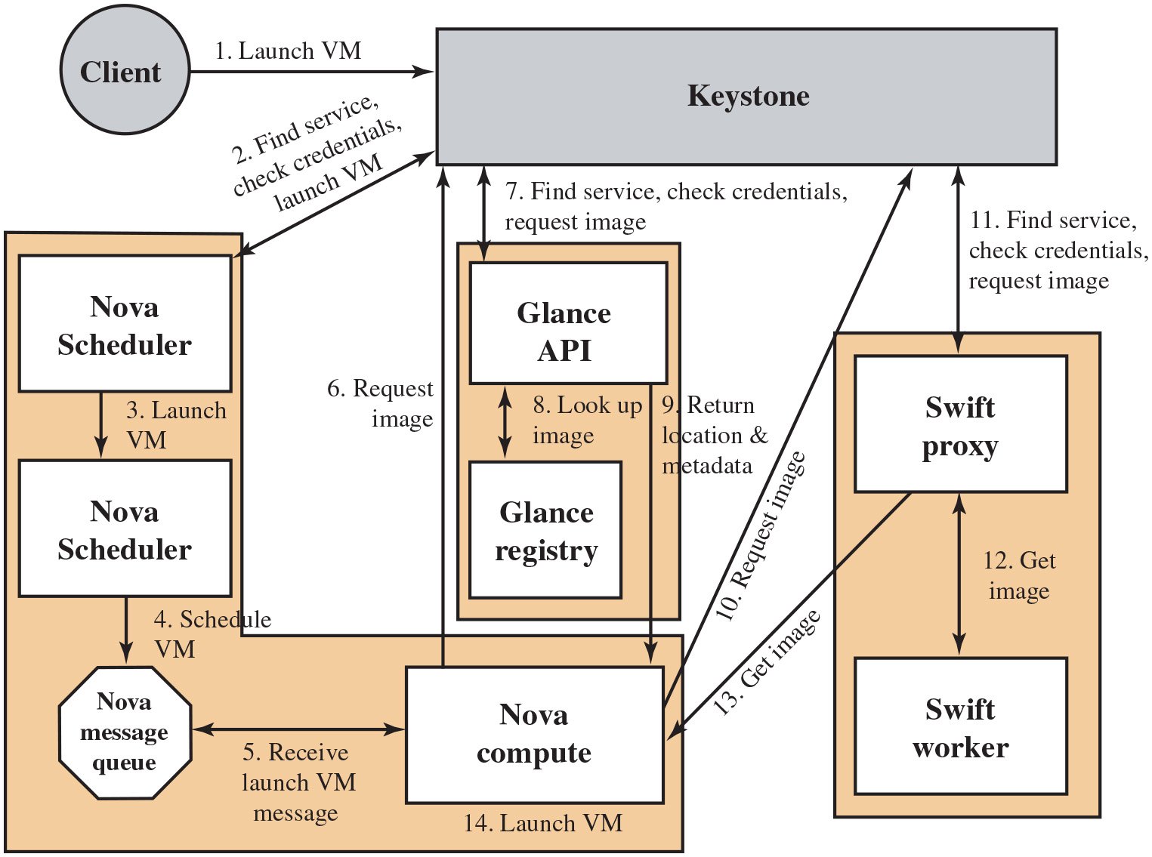
Figure 13.7
Launching a Virtual Machine in OpenStack
Notes:
Figure 13.7 illustrates the way in which Keystone interacts with other Open- Stack components to launch a new V M. Nova is the management software module that controls V M s within the I a a S cloud computing platform. It manages the lifecycle of compute instances in an OpenStack environment. Responsibilities include spawning, scheduling, and decommissioning of machines on demand. Thus, Nova enables enterprises and service providers to offer on-demand computing resources by provisioning and managing large networks of V M s. Glance is a lookup and retrieval system for V M disk images. It provides services for discovering, registering, and retrieving virtual images through an A P I. Swift is a distributed object store that creates a redundant and scalable storage space of up to multiple petabytes of data. Object storage does not present a traditional file system but rather a distributed storage system for static data such as V M images, photo storage, e-mail storage, backups, and archives. The steps are as follows. Client launches V M to keystone. 2. A bidirectional arrow between nova scheduler and keystone is labeled, find service check credentials launch V M. 3. Nova scheduler launches V M. 4. Nova scheduler schedules V M to nova message queue. Nova message queue receive launch V M message and relay to nova compute. 6. Nova compute request image to keystone. 7. Keystone send request, find service, check credentials, and request image to glance A P I. 8. Glance A P I to glance registry look up image. 9. glance A P I to nova compute return location and metadata. 10. nova compute to keystone, request image. 11. Keystone to swift proxy, find service check credentials, request image. 12. swift proxy to swift worker, get image. Swift proxy to nova compute, get image. 14. Nova compute, launch V M.
Long Description:
Back The process involves 14 steps. 1, The client sends the launch V M command to the keystone.
2, The keystone and nova scheduler exchange information for finding service, checking credentials, and launching the V M.
3, the nova scheduler sends a launch V M command to a second nova scheduler.
4, The second nova scheduler sends a schedule V M command to the nova message queue.
5, the nova message queue and nova compute component exchange messages related to launching the V M message.
6, The nova compute component sends an image request to the keystone.
7, The glance A P I and keystone exchange data for finding service, checking credentials, and requesting an image.
8, the glance A P I and glance registry exchange data for looking up the image.
9, the glance A P I returns location and metadata to the nova compute component.
10, the nova compute sends the image request to the keystone.
11, The keystone and the swift proxy exchange data for finding service, checking credentials, and requesting an image.
12, The swift proxy and swift worker exchange information for getting the image.
13, The swift proxy sends the image to the nova compute component.
14, The nova compute component launches the V M.

Slide 42
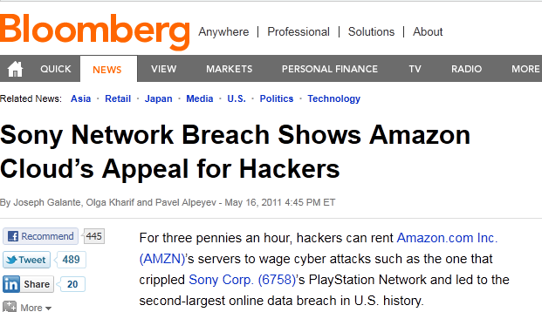
Cloud Attacks
SJW

Slide 43

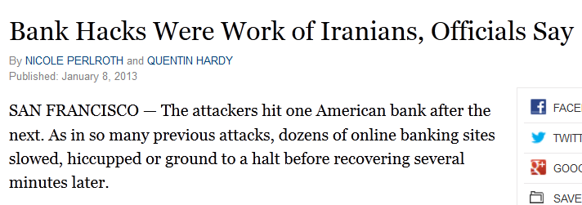
Cloud Attacks
Hijacks cloud data centers
Infects them with Itsoknoproblembro (It’s OK, No Problem, Bro)
bRobots (infected servers) difficult to trace to attacker
mounts high volume 70 Gbps DDoS system attack
targets known vulnerabilities in web content management systems
Joomla and WordPress
sends SSL (encrypted - more resource-intensive) requests, also SYN floods, UDP, ICMP attacks
Payback for economic sanctions, Stuxnet?
“Round up the usual suspects”
Casablanca
(1942)
The 2012 Verizon Data Breach Investigations Report reveals that several high-profile application-layer DDoS attacks hiding behind volumetric attacks were used to obscure data theft efforts, proving that multi-vector attacks are now used to hide the true target of the attack.
SJW

Slide 44
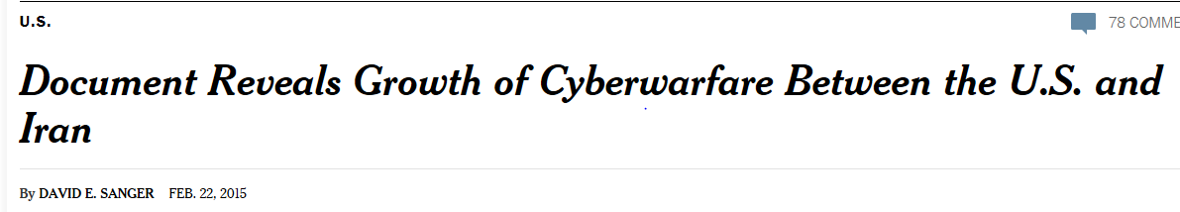

Cloud Attacks
SJW

Slide 45
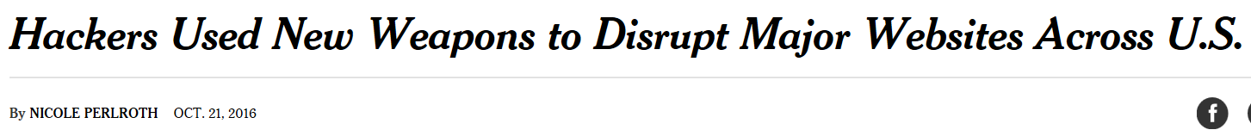
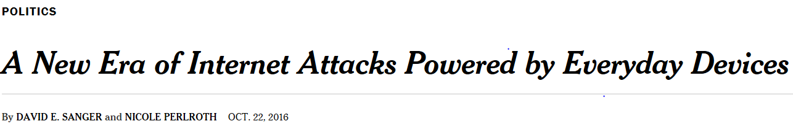
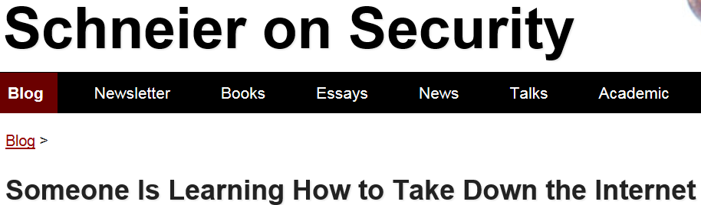
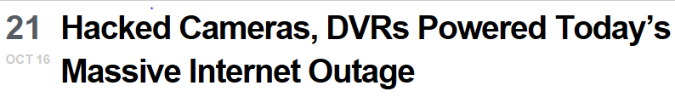
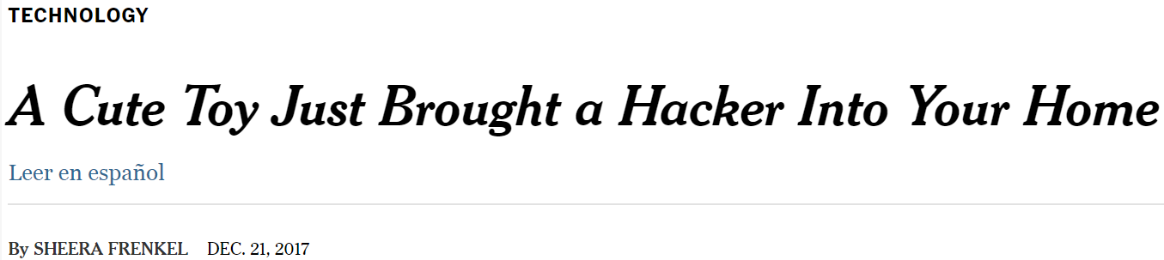
IoT Attacks
IoT Malware known as Mirai
Used factory-set passwords or no passwords
Millions of devices participated in the attack
SJW

Slide 46
The Internet of Things (I o T)
I o T is a term that refers to the expanding interconnection of smart devices, ranging from appliances to tiny sensors
A dominant theme is the embedding of short-range mobile transceivers into a wide array of gadgets and everyday items, enabling new forms of communication between people and things and between things themselves
The Internet supports the interconnectivity usually through cloud systems
The objects deliver sensor information, act on their environment, and, in some cases, modify themselves to create overall management of a larger system
The I o T is primarily driven by deeply embedded devices
These devices are low-bandwidth, low-repetition data capture and low-bandwidth data-usage appliances that communicate with each other and provide data via user interfaces
Embedded appliances, such as high-resolution video security cameras, video V o I P phones, and a handful of others, require high-bandwidth streaming capabilities
Notes:
The Internet of Things is the latest development in the long and continuing revolution of computing and communications. Its size, ubiquity, and influence on everyday lives, business, and government dwarf any technical advance that has gone before.
The Internet of Things (I o T) is a term that refers to the expanding interconnection of smart devices, ranging from appliances to tiny sensors. A dominant theme is the embedding of short-range mobile transceivers into a wide array of gadgets and everyday items, enabling new forms of communication between people and things and between things themselves. The Internet now supports the interconnection of billions of industrial and personal objects usually through cloud systems. The objects deliver sensor information, act on their environment, and, in some cases, modify themselves to create overall management of a larger system like a factory or city.
The I o T is primarily driven by deeply embedded devices. These devices are low-bandwidth, low-repetition data capture and low-bandwidth data-usage appliances that communicate with each other and provide data via user interfaces. Embedded appliances, such as high-resolution video security cameras, video V o I P phones, and a handful of others, require high-bandwidth streaming capabilities. Yet countless products simply require packets of data to be intermittently delivered.

Slide 47
Evolution (1 of 2)
With reference to the end systems supported, the Internet has gone through roughly four generations of deployment culminating in the I o T:
Information technology (I T)
P C s, servers, routers, firewalls, and so on bought as I T devices by enterprise I T people primarily using wired connectivity
Operational technology (O T)
Machines/appliances with embedded I T built by non- I T companies, such as medical machinery, S C A D A, process control, and kiosks, bought as appliances by enterprise O T people primarily using wired connectivity
Personal technology
Smartphones, tablets, and eBook readers bought as I T devices by consumers (employees) exclusively using wireless connectivity and often multiple forms of wireless connectivity
Notes:
With reference to the end systems supported, the Internet has gone through roughly four generations of deployment culminating in the I o T:
1. Information technology (I T): P C s, servers, routers, firewalls, and so on bought as I T devices by enterprise I T people primarily using wired connectivity.
2. Operational technology (O T): Machines/appliances with embedded I T built by non-I T companies, such as medical machinery, S C A D A (supervisory control and data acquisition), process control, and kiosks, bought as appliances by enterprise O T people primarily using wired connectivity.
3. Personal technology: Smartphones, tablets, and eBook readers bought as I T devices by consumers (employees) exclusively using wireless connectivity and often multiple forms of wireless connectivity.
4. Sensor/actuator technology: Single-purpose devices bought by consumers, I T, and O T people exclusively using wireless connectivity generally of a single form as part of larger systems.
The fourth generation is usually thought of as the I o T and marked by using billions of embedded devices.

Slide 48
Evolution (2 of 2)
Sensor/actuator technology
Single-purpose devices bought by consumers, I T, and O T people exclusively using wireless connectivity generally of a single form as part of larger systems
The fourth generation is usually thought of as the I o T and marked by the use of billions of embedded devices

Slide 49
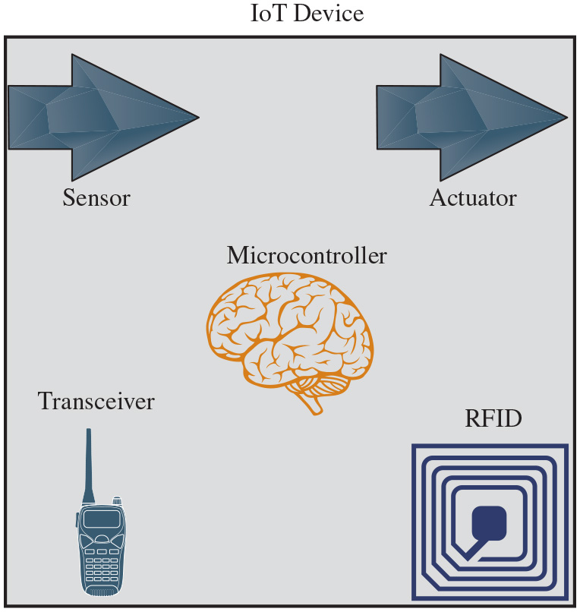
Figure 13.8
I o T Components
Notes:
The key components of an I o T-enabled device are the following (see Figure 13.8):
• Sensor: A sensor measures some parameter of a physical, chemical, or biological entity and delivers an electronic signal proportional to the observed characteristic, either in the form of an analog voltage level or a digital signal. In both cases, the sensor output is typically input to a microcontroller or other management element.
• Actuator: An actuator receives an electronic signal from a controller and responds by interacting with its environment to produce an effect on some parameter of a physical, chemical, or biological entity.
• Microcontroller: The “smart” in a smart device is provided by a deeply embedded microcontroller.
• Transceiver: A transceiver contains the electronics needed to transmit and receive data. Most IoT devices contain a wireless transceiver capable of communication using Wi-Fi, ZigBee, Bluetooth, or some other wireless scheme.
• Radio-frequency Identification (R F I D): R F I D technology, which uses radio waves to identify items, is increasingly becoming an enabling technology for I o T. The main elements of an R F I D system are tags and readers. R F I D tags are small programmable devices used for object, animal, and human tracking. They come in a variety of shapes, sizes, functionalities, and costs. R F I D readers acquire and sometimes rewrite information stored on R F I D tags that come within operating range (a few inches up to several feet). Readers are usually connected to a computer system that records and formats the acquired information for further uses.
Long Description:
In the I o T, the microcontroller is like a brain, receiving signals from the sensors and sending signals to the actuator. The I o T includes a transceiver and R F I D.

Slide 50
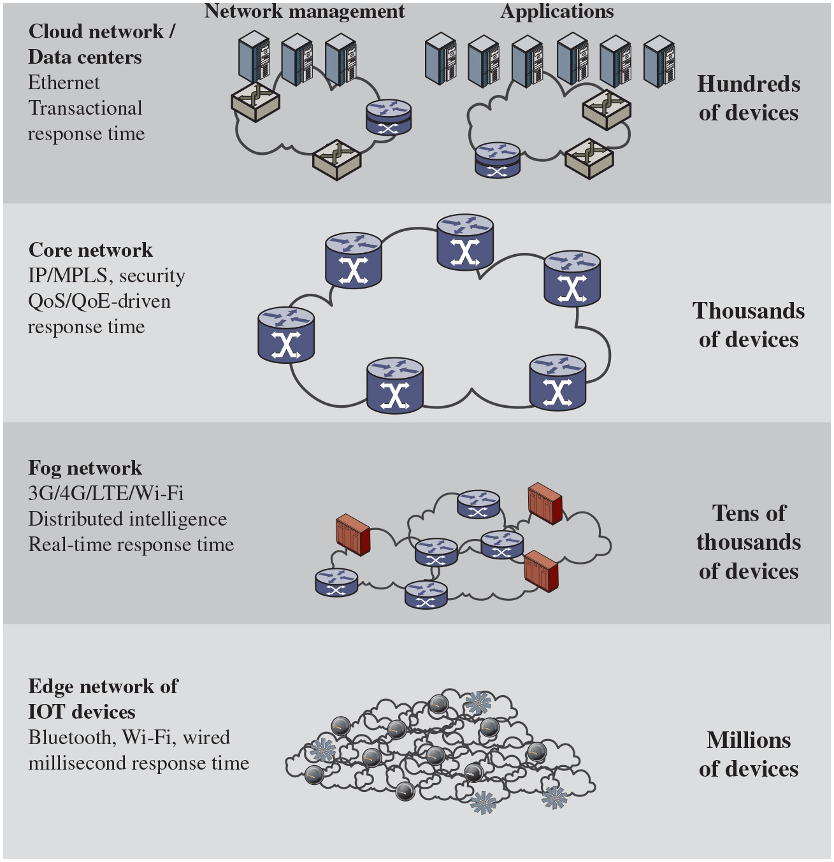
Figure 13.9
The I o T/Cloud Context
Notes:
To better understand the function of an IoT, it is useful to view it in the context of a complete enterprise network that includes third-party networking and cloud computing elements. Figure 13.9 provides an overview illustration. The cloud network or data centers with ethernet, transactional response time, has hundreds of devices connected with separate network management and applications. The core network key features are I P or M P L S, security Q o S or Q o E driven response time, has thousands of devices connected together. Fog network, tens of thousands of devices are connected together with features, 3 G or 4 G or L T E or Wi-Fi distributed intelligence, and with real time response time. Edge network of I o T devices, millions of devices connected together with Bluetooth,
Wi-Fi and with millisecond response time.
Long Description:
The diagram defines different systems and networks by number of involved devices. The data center or cloud consists of hundreds of devices with network management and applications. This type of system includes the ethernet, and it has transactional response time. Core networks consist of thousands of devices. They include the I P or M P L S with security and Q o S or Q o E driven response time. The fog network consists of tens of thousands of devices, communicating via 3 G, 4 G, L T E, and wi-fi. They have distributed intelligence and real-time response time. The Edge network of I O T devices consists of millions of devices, communicating via blue tooth and wi-fi with millisecond response time.

Slide 51
Edge
At the edge of a typical enterprise network is a network of I o T-enabled devices consisting of sensors and perhaps actuators
These devices may communicate with one another
A cluster of sensors may all transmit their data to one sensor that aggregates the data to be collected by a higher-level entity
A gateway interconnects the I o T-enabled devices with the higher-level communication networks
It performs the necessary translation between the protocols used in the communication networks and those used by devices
It may also perform a basic data aggregation function
Notes:
At the edge of a typical enterprise network is a network of I o T-enabled devices consisting of sensors and perhaps actuators. These devices may communicate with one another. For example, a cluster of sensors may all transmit their data to one sensor that aggregates the data to be collected by a higher-level entity. At this level also there may also be a number of gateways. A gateway interconnects the I o T-enabled devices with the higher-level communication networks. It performs the necessary translation between the protocols used in the communication networks and those used by devices. A gateway may also perform a basic data aggregation function.

Slide 52
Fog (1 of 3)
In many I o T deployments, massive amounts of data may be generated by a distributed network of sensors
Rather than store all of that data permanently (or at least for a long period) in central storage accessible to I o T applications, it is often desirable to do as much data processing close to the sensors as possible
The purpose of what is sometimes referred to as the edge computing level is to convert network data flows into information that is suitable for storage and higher-level processing
Processing elements at these levels may deal with high volumes of data and perform data transformation operations, resulting in the storage of much lower volumes of data
The following are examples of fog computing operations:
Evaluation
Formatting
Expanding/decoding
Distillation/reduction
Assessment
Notes:
In many I o T deployments, massive amounts of data may be generated by a distributed network of sensors. For example, offshore oil fields and refineries can generate a terabyte of data per day. An airplane can create multiple terabytes of data per hour. Rather than store all of that data permanently (or at least for a long period) in central storage accessible to I o T applications, it is often desirable to do as much data processing close to the sensors as possible. Thus, the purpose of what is sometimes referred to as the edge computing level is to convert network data flows into information that is suitable for storage and higher-level processing. Processing elements at these level may deal with high volumes of data and perform data transformation operations, resulting in the storage of much lower volumes of data.
The following are examples of fog computing operations:
• Evaluation: Evaluating data for criteria as to whether it should be processed at a higher level.
• Formatting: Reformatting data for consistent higher-level processing.
• Expanding/decoding: Handling cryptic data with additional context (such as the origin).
• Distillation/reduction: Reducing and/or summarizing data to minimize the impact of data and traffic on the network and higher-level processing systems.
• Assessment: Determining whether data represents a threshold or alert; this could include redirecting data to additional destinations.

Slide 53
Fog (2 of 3)
Generally, fog computing devices are deployed physically near the edge of the I o T network near the sensors and other data-generating devices
Fog computing and fog services are expected to be a distinguishing characteristic of the I o T
Fog computing represents an opposite trend in modern networking from cloud computing
With cloud computing, massive, centralized storage and processing resources are made available to distributed customers over cloud networking facilities to a relatively small number of users
With fog computing, massive numbers of individual smart objects are interconnected with fog networking facilities that provide processing and storage resources close to the edge devices in an I o T
Notes:
Generally, fog computing devices they are deployed physically near the edge of the I o T network; that is, near the sensors and other data-generating devices. Thus, some of the basic processing of large volumes of generated data is offloaded and outsourced from IoT application software located at the center.
Fog computing and fog services are expected to be a distinguishing characteristic of the I o T. Fog computing represents an opposite trend in modern networking from cloud computing. With cloud computing, massive, centralized storage and processing resources are made available to distributed customers over cloud networking facilities to a relatively small number of users. With fog computing, massive numbers of individual smart objects are interconnected with fog networking facilities that provide processing and storage resources close to the edge devices in an I o T. Fog computing addresses the challenges raised by the activity of thousands or millions of smart devices, including security, privacy, network capacity constraints, and latency requirements. The term fog computing is inspired by the fact that fog tends to hover low to the ground whereas clouds are high in the sky.

Slide 54
Fog (3 of 3)
Fog computing addresses the challenges raised by the activity of thousands or millions of smart devices, including security, privacy, network capacity constraints, and latency requirements
The term fog computing is inspired by the fact that fog tends to hover low to the ground whereas clouds are high in the sky

Slide 55
Core
The core network, also referred to as a backbone network, connects geographically dispersed fog networks as well as providing access to other networks that are not part of the enterprise network
Typically, the core network will use very high-performance routers, high-capacity transmission lines, and multiple interconnected routers for increased redundancy and capacity
The core network may also connect to high-performance, high-capacity servers such as large database servers and private cloud facilities
Some of the core routers may be purely internal, providing redundancy and additional capacity without serving as edge routers
Notes:
The core network, also referred to as a backbone network, connects geographically dispersed fog networks as well as providing access to other networks that are not part of the enterprise network. Typically, the core network will use very high-performance routers, high-capacity transmission lines, and multiple interconnected routers for increased redundancy and capacity. The core network may also connect to high-performance, high-capacity servers such as large database servers and private cloud facilities. Some of the core routers may be purely internal, providing redundancy and additional capacity without serving as edge routers.

Slide 56
Table 13.4
Comparison of Cloud and Fog Features
Blank | Cloud | Fog
Location of processing/storage resources | Center | Edge
Latency | High | Low
Access | Fixed or wireless | Mainly wireless
Support for mobility | Not applicable | Yes
Control | Centralized/hierarchical (full control) | Distributed/hierarchical (partial control)
Service access | Through core | At the edge/on handheld device
Availability | 99.99% | Highly volatile/highly redundant
Number of users/devices | Tens/hundreds of millions | Tens of billions
Main content generator | Human | Devices/sensors
Content generation | Central location | Anywhere
Content consumption | End device | Anywhere
Software virtual infrastructure | Central enterprise servers | User devices
Notes:
The cloud network provides storage and processing capabilities for the massive amounts of aggregated data that originate in I o T-enabled devices at the edge. Cloud servers also host the applications that (1) interact with and manage the IoT devices, and (2) analyze the I o T-generated data.
Table 13.4 compares cloud and fog computing.

Slide 57
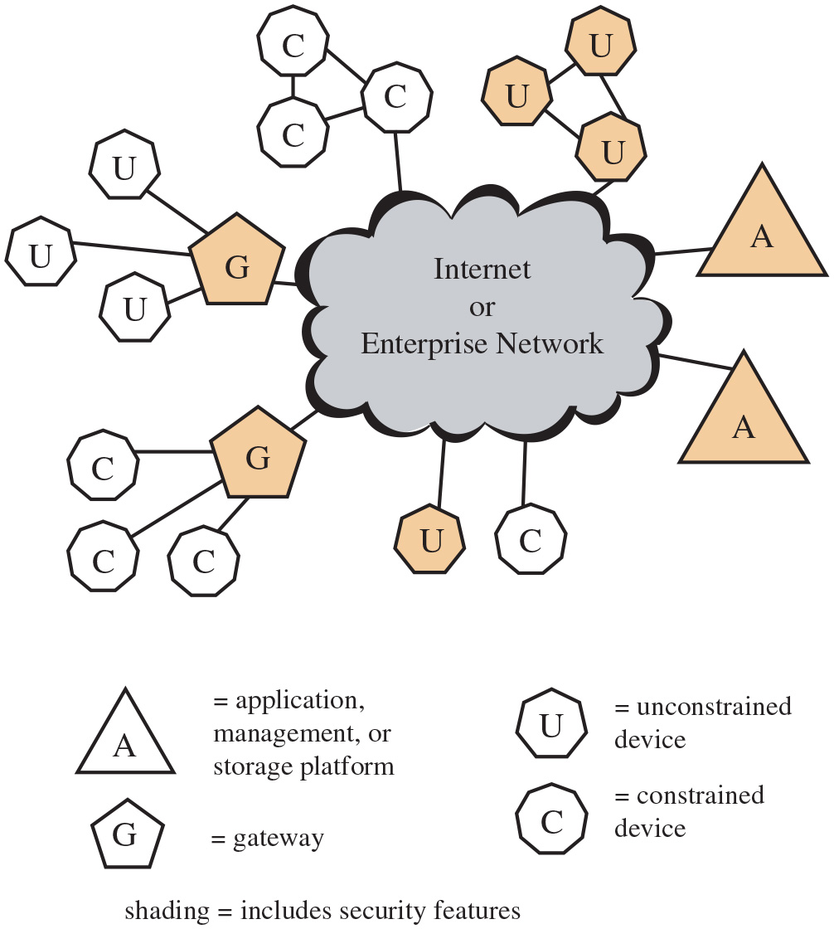
Figure 13.10
I o T Security: Elements of Interest
Notes:
I o T is perhaps the most complex and undeveloped area of network security. This was demonstrated in the 2016 Mirai massive distributed denial of service attack that severely disrupted Internet access on the U.S. east coast. The Mirai botnet used hundreds of thousands of compromised IoT devices to generate the attack traffic, graphically illustrating the danger posed by weak security on such devices. To see this, consider Figure 13.10, which shows the main elements of interest for I o T security. At the center of the network are the application platforms, data storage servers, and network and security management systems. These central systems gather data from sensors, send control signals to actuators, and are responsible for managing the I o T devices and their communication networks. At the edge of the network are I o T-enabled devices, some of which are quite simple constrained devices and some of which are more intelligent unconstrained devices. As well, gateways may perform protocol conversion and other networking service on behalf of I o T devices.
Figure 13.10 illustrates a number of typical scenarios for interconnection and the inclusion of security features. The shading in Figure 13.10 indicates the systems that support at least some of these functions. Typically, gateways will implement secure functions, such as T L S and I P sec. Unconstrained devices may or may not implement some security capability. Constrained devices generally have limited or no security features. As suggested in the figure, gateway devices can provide secure communication between the gateway and the devices at the center, such as application platforms and management platforms. However, any constrained or unconstrained devices attached to the gateway are outside the zone of security established between the gateway and the central systems. As shown, unconstrained devices can communicate directly with the center and support security functions. However, constrained devices that are not connected to gateways have no secure communications with central devices. At the center of the network are the application platforms, data storage servers, and network and security management systems. These central systems gather data from sensors, send control signals to actuators, and are responsible for managing the I o T devices and their communication networks. At the edge of the network are I o T enabled devices, some of which are quite simple constrained devices, and some of which are more intelligent unconstrained devices. A number of typical scenarios for interconnection and the inclusion of security features are presented. The shading indicates the systems that support at least some of these functions including security. Gateway devices can provide secure communication between the gateway and the devices at the center, such as application platforms and management platforms.
Long Description:
The internet or enterprise network connects directly to systems consisting of constrained and unconstrained devices, as well as applications, management, and the storage platform. The network also accesses groups of constrained and unconstrained devices via gateways. Gateways, unconstrained devices directly connected to the network, and applications, management, and storage platforms include security features.

Slide 58
Patching Vulnerability
At a crisis point with regard to the security of embedded systems, including I o T devices
The embedded devices are riddled with vulnerabilities; no good way to patch them
Chip manufacturers have strong incentives to produce their product as quickly and cheaply as possible
The device manufacturers focus is the functionality of the device itself
The end user may have no means of patching the system or, if so, little information about when and how to patch
Result is 100s of millions of Internet-connected devices vulnerable to attack
Problem with sensors allowing attackers to insert false data into the network
It is potentially a graver threat with actuators where the attacker can affect the operation of machinery and other devices
Schneier’s article in Wired magazine:
SJW
Notes:
In an often-quoted 2014 article, security expert Bruce Schneier stated that we are at a crisis point with regard to the security of embedded systems, including IoT devices [S C H N 14]. The embedded devices are riddled with vulnerabilities, and there is no good way to patch them. The chip manufacturers have strong incentives to produce their product with its firmware and software as quickly and cheaply as possible. The device manufacturers choose a chip based on price and features and do very little if anything to the chip software and firmware. Their focus is the functionality of the device itself. The end user may have no means of patching the system or, if so, little information about when and how to patch. The result is that the hundreds of millions of Internet-connected devices in the I o T are vulnerable to attack. This is certainly a problem with sensors, allowing attackers to insert false data into the network. It is potentially a graver threat with actuators where the attacker can affect the operation of machinery and other devices.

Slide 59
I o T Security and Privacy Requirements
I T U-T Recommendation Y.2066 includes a list of security requirements for the I o T
The requirements are defined as being the functional requirements during capturing, storing, transferring, aggregating, and processing the data of things, as well as to the provision of services that involve things
The requirements are:
Communication security
Data management security
Service provision security
Integration of security policies and techniques
Mutual authentication and authorization
Security audit
Notes:
I T U-T Recommendation Y.2066 (Common Requirements of the Internet of Things, June 2014) includes a list of security requirements for the I o T. This list is a useful baseline for understanding the scope of security implementation needed for an IoT deployment. The requirements are defined as being the functional requirements during capturing, storing, transferring, aggregating, and processing the data of things, as well as to the provision of services that involve things. These requirements are related to all the I o T actors. The requirements are the following:
• Communication security: Secure, trusted, and privacy protected communication capability is required, so unauthorized access to the content of data can be prohibited, integrity of data can be guaranteed, and privacy-related content of data can be protected during data transmission or transfer in I o T.
• Data management security: Secure, trusted, and privacy protected data management capability is required, so unauthorized access to the content of data can be prohibited, integrity of data can be guaranteed, and privacy-related content of data can be protected when storing or processing data in I o T.
• Service provision security: Secure, trusted, and privacy protected service provision capability is required, so unauthorized access to service and fraudulent service provision can be prohibited, and privacy information related to I o T users can be protected.
• Integration of security policies and techniques: The ability to integrate different security policies and techniques is required so as to ensure a consistent security control over the variety of devices and user networks in I o T.
• Mutual authentication and authorization: Before a device (or an I o T user) can access the I o T, mutual authentication and authorization between the device (or the I o T user) and I o T is required to be performed according to predefined security policies
.
• Security audit: Security audit is required to be supported in I o T. Any data access or attempt to access I o T applications are required to be fully transparent, traceable, and reproducible according to appropriate regulation and laws. In particular, I o T is required to support security audit for data transmission, storage, processing, and application access.

Slide 60
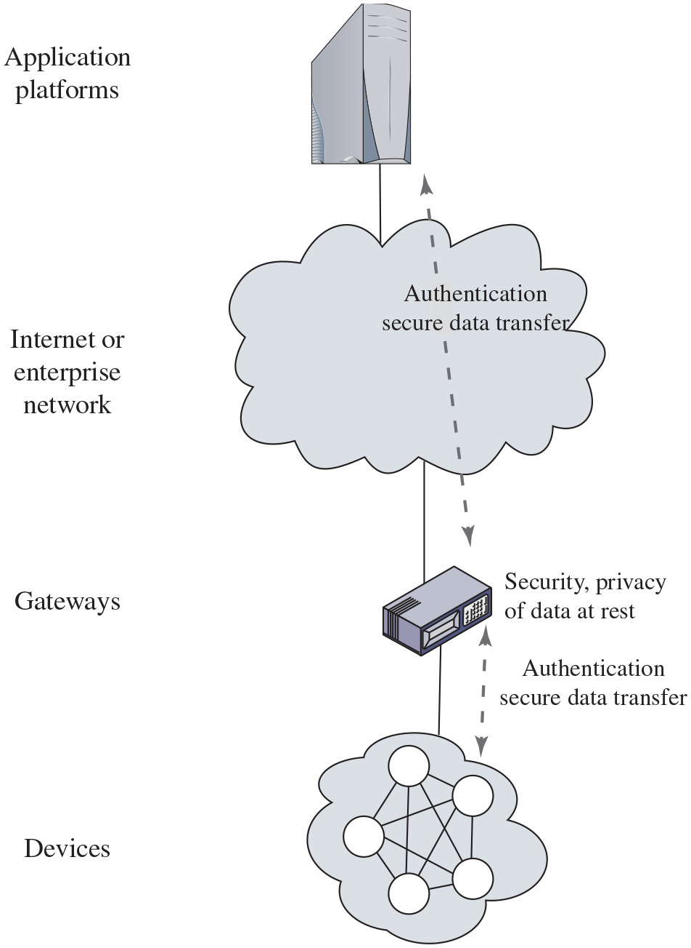
Figure 13.11
I o T Gateway Security Functions
Notes:
A key element in providing security in an IoT deployment is the gateway. I T U-T Recommendation Y.2067 (Common Requirements and Capabilities of a Gateway for Internet of Things Applications, June 2014) details specific security functions that the gateway should implement, some of which are illustrated in Figure 13.11. These consist of the following:
• Support identification of each access to the connected devices.
• Support authentication with devices. Based on application requirements and device capabilities, it is required to support mutual or one-way authentication with devices. With one-way authentication, either the device authenticates itself to the gateway or the gateway authenticates itself to the device but not both.
• Support mutual authentication with applications.
• Support the security of the data that are stored in devices and the gateway, transferred between the gateway and devices, or transferred between the gateway and applications. Support the security of these data based on security levels.
• Support mechanisms to protect privacy for devices and the gateway.
• Support self-diagnosis and self-repair as well as remote maintenance.
• Support firmware and software update.
• Support auto configuration or configuration by applications. The gateway is required to support multiple configuration modes, for example, remote and local configuration, automatic and manual configuration, and dynamic configuration based on policies.
Some of these requirements may be difficult to achieve when they involve providing security services for constrained devices. For example, the gateway should support security of data stored in devices. Without encryption capability at the constrained device, this may be impractical to achieve.
Note the Y.2067 requirements make a number of references to privacy requirements. Privacy is an area of growing concern with the widespread deployment of I o T-enabled things in homes, retail outlets, and vehicles and humans. As more things are interconnected, governments and private enterprises will collect massive amounts of data about individuals, including medical information, location and movement information, and application usage. The devices are connected to the application platforms through gateways. The gateways are connected to the application platforms. The gateway ensures the security, privacy of data at each step.
Long Description:
Gateways provide security and privacy for data at rest. Via authentication, gateways also allow for secure data transfer from devices to the gateway and from the gateway through the internet or enterprise network to application platform, and with interaction of authentication secure data transfer.

Slide 61
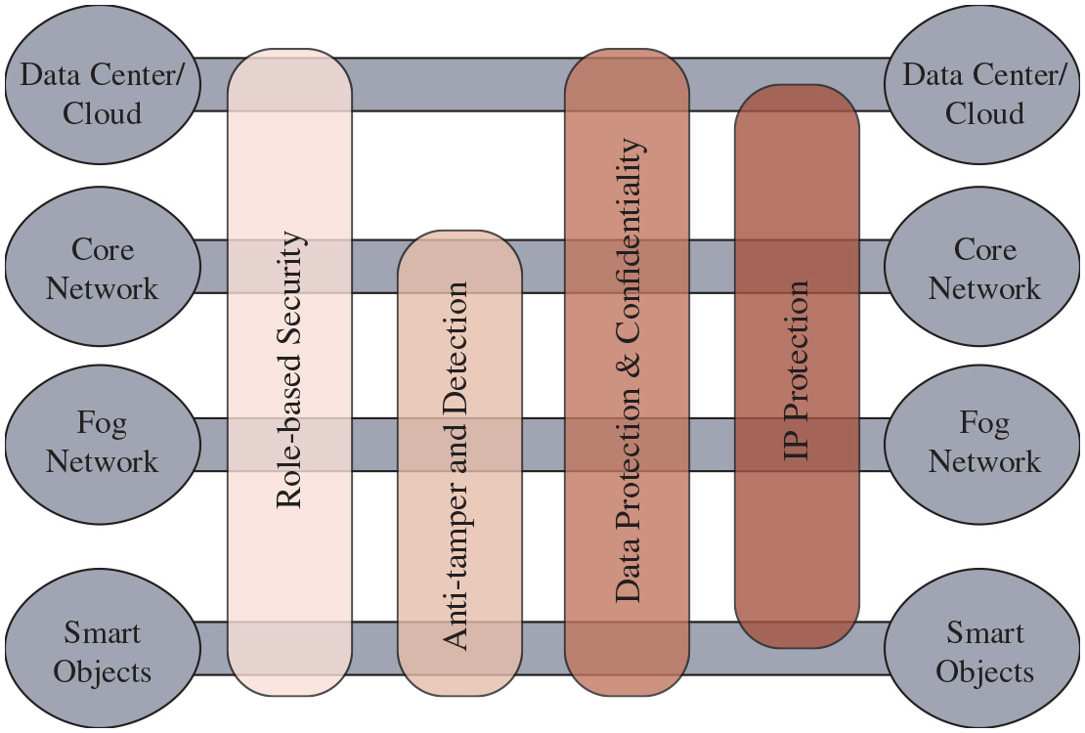
Figure 13.12
I o T Security Environment
Notes:
Cisco has developed a framework for IoT security [F R A H 15] that serves as a useful guide to the security requirements for I o T. Figure 13.12 illustrates the security environment related to the logical structure of an I o T. The I o T model is a simplified version of the World Forum I o T Reference Model. It consists of the following levels:
• Smart objects/embedded systems: Consists of sensors, actuators, and other embedded systems at the edge of the network. This is the most vulnerable part of an I o T. The devices may not be in a physically secure environment and may need to function for years. Availability is certainly an issue. Network managers also need to be concerned about the authenticity and integrity of the data generated by sensors and about protecting actuators and other smart devices from unauthorized use. Privacy and protection from eavesdropping may also be requirements.
• Fog/edge network: This level is concerned with the wired and wireless interconnection of I o T devices. In addition, a certain amount of data processing and consolidation may be done at this level. A key issue of concern is the wide variety of network technologies and protocols used by the various I o T devices and the need to develop and enforce a uniform security policy.
• Core network: The core network level provides data paths between network center platforms and the I o T devices. The security issues here are those confronted in traditional core networks. However, the vast number of endpoints to interact with and manage creates a substantial security burden.
• Data center/cloud: This level contains the application, data storage, and network management platforms. I o T does not introduce any new security issues at this level other than the necessity of dealing with huge numbers of individual endpoints.
Within this four-level architecture, the Cisco model defines four general security capabilities that span multiple levels:
• Role-based security: R B A C systems assign access rights to roles instead of individual users. In turn, users are assigned to different roles, either statically or dynamically, according to their responsibilities. R B A C enjoys widespread commercial use in cloud and enterprise systems and is a well-understood tool that can be used to manage access to I o T devices and the data they generate.
• Anti-tamper and detection: This function is particularly important at the device and fog network levels but also extends to the core network level. All of these levels may involve components that are physically outside the area of the enterprise that is protected by physical security measures.
• Data protection and confidentiality: These functions extend to all level of the architecture.
• Internet protocol protection: Protection of data in motion from eavesdropping and snooping is essential between all levels.
Figure 13.12 maps specific security functional areas across the four layers of the I o T model. It consists of the following levels. Data center or cloud, core network, fog network, and smart objects. The model defines four general security capabilities that span multiple levels. Role based security, includes all levels. Anti tamper and detection includes core network, fog network, and smart objects levels. Data protection and confidentiality and I P protection spans all levels.
Long Description:
The following list provides the networks serviced by each security measure. Role-based security, data center or cloud, core network, fog network, smart objects. Anti-tamper detection. core network, fog network, smart objects. Data protection and confidentiality, data center or cloud, core network, fog network, smart objects. I P protection, data center or cloud, core network, fog network, smart objects.

Slide 62
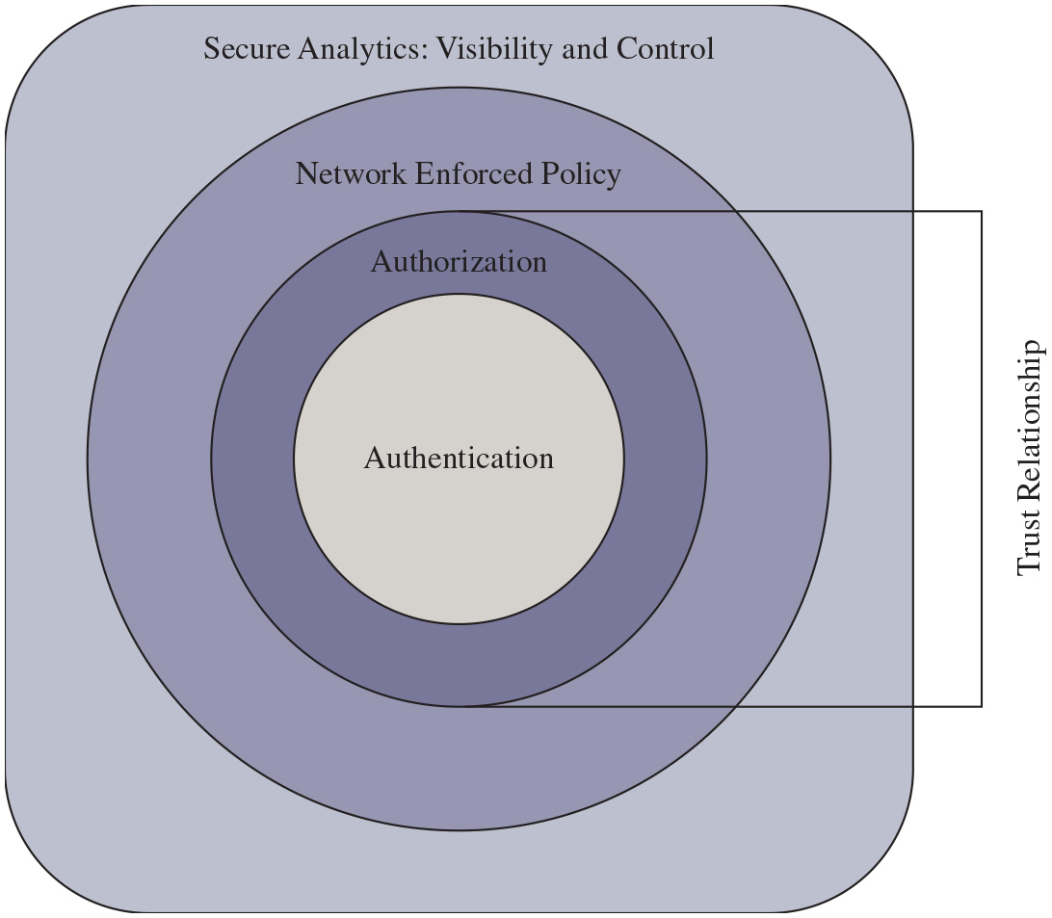
Figure 13.13
Secure I o T Framework
Notes:
[F R A H 15] also proposes a secure I o T framework that defines the components of a security facility for an I o T that encompasses all the levels as shown in Figure 13.13. The four components are:
• Authentication: Encompasses the elements that initiate the determination of access by first identifying the IoT devices. In contrast to typical enterprise network devices, which may be identified by a human credential (e.g., username and password or token), the I o T endpoints must be fingerprinted by means that do not require human interaction. Such identifiers include R F I D, x.509 certificates, or the M A C address of the endpoint.
• Authorization: Controls a device’s access throughout the network fabric. This element encompasses access control. Together with the authentication layer, it establishes the necessary parameters to enable the exchange of information between devices and between devices and application platforms and enables IoT-related services to be performed.
• Network enforced policy: Encompasses all elements that route and transport endpoint traffic securely over the infrastructure, whether control, management, or actual data traffic.
• Secure analytics, including visibility and control: This component includes all the functions required for central management of I o T devices. This involves, firstly, visibility of I o T devices, which simply means that central management services are securely aware of the distributed I o T device collection, including identity and attributes of each device. Building on this visibility is the ability to exert control, including configuration, patch updates, and threat countermeasures.
An important concept related to this framework is that of trust relationship. In this context, trust relationship refers to the ability of the two partners to an exchange to have confidence in the identity and access rights of the other. The authentication component of the trust framework provides a basic level of trust, which is expanded with the authorization component. [F R A H 15] gives the example that a car may establish a trust relationship with another car from the same vendor. That trust relationship, however, may only allow cars to exchange their safety capabilities. When a trusted relationship is established between the same car and its dealer’s network, the car may be allowed to share additional information, such as its odometer reading and last maintenance record.
N I S T I R 8259 (Recommendations for I o T Device Manufacturers: Foundational Activities May 2020) defines a set of activities for manufacturers to follow in order to
improve the security of their I o T devices. These activities involve considering which cybersecurity capabilities may be required as they develop and support their devices. The associated N I S T I R 8259A/B baselines specify a common set of core capabilities for these devices which are useful across a broad range of applications. The 2020 US “I o T Cybersecurity Improvement Act” mandates that all U.S. government agencies only use IoT devices that comply with N I S T I R 8259 and related standards. The four components are as follows. The secure analytics visibility and control includes network enforced policy, authorization, and authentication. Authorization and authentication together are the requisites for trust relationships.
Long Description:
The I o T framework has four concentric layers listed from the center outward. authentication, authorization, network enforced policy, secure analytics including visibility and control. The trust relationship depends on authentication and authorization.

Slide 63
MiniSec (1 of 2)
MiniSec is an open-source security module that is part of the TinyOS operating system
It is designed to be a link-level module that offers a high level of security, while simultaneously keeping energy consumption low and using very little memory
MiniSec provides confidentiality, authentication, and replay protection
MiniSec has two operating modes, one tailored for single-source communication, and another tailored for multi-source broadcast communication
Notes:
This section provides an overview of MiniSec, an open-source security module that is part of the TinyO S operating system. TinyO S is designed for small embedded systems with tight requirements on memory, processing time, real-time response, and power consumption. It is one of several specialized operating systems designed for IoT devices. TinyO S takes the process of streamlining quite far, resulting in a very minimal O S for embedded systems with a typical configuration requiring 48 K B of code and 10 K B of RAM [L E V I 12]. The main application of TinyO S is wireless sensor networks, and it has become the de facto O S for such networks. With sensor networks the primary security concerns relate to wireless communications. MiniSec is designed to be a link-level module that offers a high level of security, while simultaneously keeping energy consumption low and using very little memory [L U K 07]. MiniSec provides confidentiality, authentication, and replay protection.
MiniSec has two operating modes, one tailored for single-source communication, and another tailored for multi-source broadcast communication. The latter does not require per-sender state for replay protection and, thus, scales to large networks.

Slide 64
MiniSec (2 of 2)
MiniSec is designed to meet the following requirements:
Data authentication
Confidentiality
Replay protection
Freshness
Low energy overhead
Resilient to lost messages
Notes:
MiniSec is designed to meet the following requirements:
• Data authentication: Enables a legitimate node to verify whether a message originated from another legitimate node (i.e., a node with which it shares a secret key) and was unchanged during transmission.
• Confidentiality: A basic requirement for any secure communications system.
• Replay protection: Prevents an attacker from successfully recording a packet and replaying it at a later time.
• Freshness: Because sensor nodes often stream time-varying measurements, providing guarantee of message freshness is an important property. There are two types of freshness: Strong and weak. MiniSec provides a mechanism to guarantee weak freshness, where a receiver can determine a partial ordering over received messages without a local reference time point.
• Low energy overhead: This is achieved by minimizing communication overhead and by using only symmetric encryption.
• Resilient to lost messages: The relatively high occurrence of dropped packets in wireless sensor networks requires a design that can tolerate high message loss rates.
Two cryptographic algorithms used by MiniSec are worth noting. The first of these is the encryption algorithm Skipjack. Skipjack was developed in the 1990s by the U.S. National Security Agency (N S A). It is one of the simplest and fastest block cipher algorithms, which is critical to embedded systems. A study of eight possible candidate algorithms for wireless security networks [L A W 06] concluded that Skipjack was the best algorithm in terms of code memory, data memory, encryption/decryption efficiency, and key setup efficiency.
Skipjack makes use of an 80-bit key. It was intended by N S A to provide a secure system once it became clear that D E S with only a 56-bit key, was vulnerable. Contemporary algorithms, such as A E S, employ a key length of at least 128 bits, and 80 bits is generally considered inadequate. However, for the limited application of wireless sensor networks and other IoT devices, which provide large volumes of short data blocks over a slow data link, Skipjack suffices. With its efficient computation and low memory footprint, Skipjack is an attractive choice for IoT devices.
The block cipher mode of operation chosen for MiniSec is the Offset Codebook (O C B) mode. As mentioned in Chapter 2, a mode of operation must be specified when a plaintext source consists of multiple blocks of data to be encrypted with the same encryption key. O C B mode is provably secure assuming the underlying block cipher is secure. O C B mode is a one-pass mode of operation making it highly efficient. Only one block cipher call is necessary for each plaintext block (with an additional two calls needed to complete the whole encryption process). O C B is especially well suited for the stringent energy constraints of sensor nodes.
A feature that contributes significantly to the efficiency of O C B is that with one pass through the sequence of plaintext blocks, it produces a ciphertext of equal length and a tag for authentication. To decrypt a ciphertext, the receiver performs the reverse process to recover the plaintext. Then, the receiver ensures that the tag is as expected. If the receiver computes a different tag than the one accompanying the ciphertext, the ciphertext is considered to be invalid. Thus, both message authentication and message confidentiality are achieved with a single, simple algorithm. O C B will be described in Chapter 21.
MiniSec employs per-device keys; that is, each key is unique to a particular pair of devices to prevent replay attacks.

Slide 65
Summary (1 of 3)
Cloud computing
Cloud computing elements
Cloud service models
Cloud deployment models
Cloud computing reference architecture
Cloud security concepts
Security issues for cloud computing
Addressing cloud computing security concerns
Notes:
Chapter 13 summary.

Slide 66
Summary (2 of 3)
Cloud security approaches
Risks and countermeasures
Data protection in the cloud
Security approaches for cloud computing assets
Cloud security as a service
Open-source cloud security module
The Internet of Things
Things on the Internet of Things
Evolution
Components of I o T-enabled things
I o T and cloud context

Slide 67
Summary (3 of 3)
I o T security
The patching vulnerability
I o T security and privacy requirements defined by I T U-T
An I o T security framework
An open-source I o T security module

Slide 68

Copyright
This work is protected by United States copyright laws and is provided solely for the use of instructors in teaching their courses and assessing student learning. Dissemination or sale of any part of this work (including on the World Wide Web) will destroy the integrity of the work and is not permitted. The work and materials from it should never be made available to students except by instructors using the accompanying text in their classes. All recipients of this work are expected to abide by these restrictions and to honor the intended pedagogical purposes and the needs of other instructors who rely on these materials.

